Slide 1
Fresh Intranet - Feature catalog
August 2025

Slide 2


We are Fresh
We are Fresh
Fresh, a product launched by the Advania Group in 2015, is an enterprise-class intranet solution designed not just around features but based on real intranet usage scenarios.
Built on the power of Microsoft 365, SharePoint, Teams and Viva, Fresh runs on your Microsoft environment, complying with your business requirements.
Fresh’s focus on user experience, accessibility and Microsoft 365 ensures a seamless, inclusive and efficient experience for your employees in the hybrid work landscape.

Slide 3
What's new in Fresh Intranet V2025-R3
New functionalities
Enhancements
Fresh Teams intranet app
Newsletters analytics:
Open rate
Click-through rate
Newsletter enhancements:
Header image settings
Footer settings
Letter template (rich text without items)
Sections
Clear cache app in the Admin panel
Accessibility enhancements for People search and Curated people
FreshMind: Messaging to comply with AI transparency
Page cards: Image resolution fixes
Events: Tooltip to show full title

Slide 4
Core intranet

Slide 5
Example of intranet structure
Department Sites Hub
Additional Sites
Community Sites Hub
Comms Centre
Home
Alerts
Events
Alerts
Events
Intranet
Home page
Tools
Collaboration
Tools
Admin Portal
Analytics
Configuration
Content engagement
Landing page x
News
Search
Department Site 1
Content Site 1
Community Site 1
Configuration
Documents
Documents
Documents
Web analytics
Department Site X
Content Site X
Community Site X
Content engagement
Documents
Documents
Documents
Site collection
List
Page
Document library

Slide 6
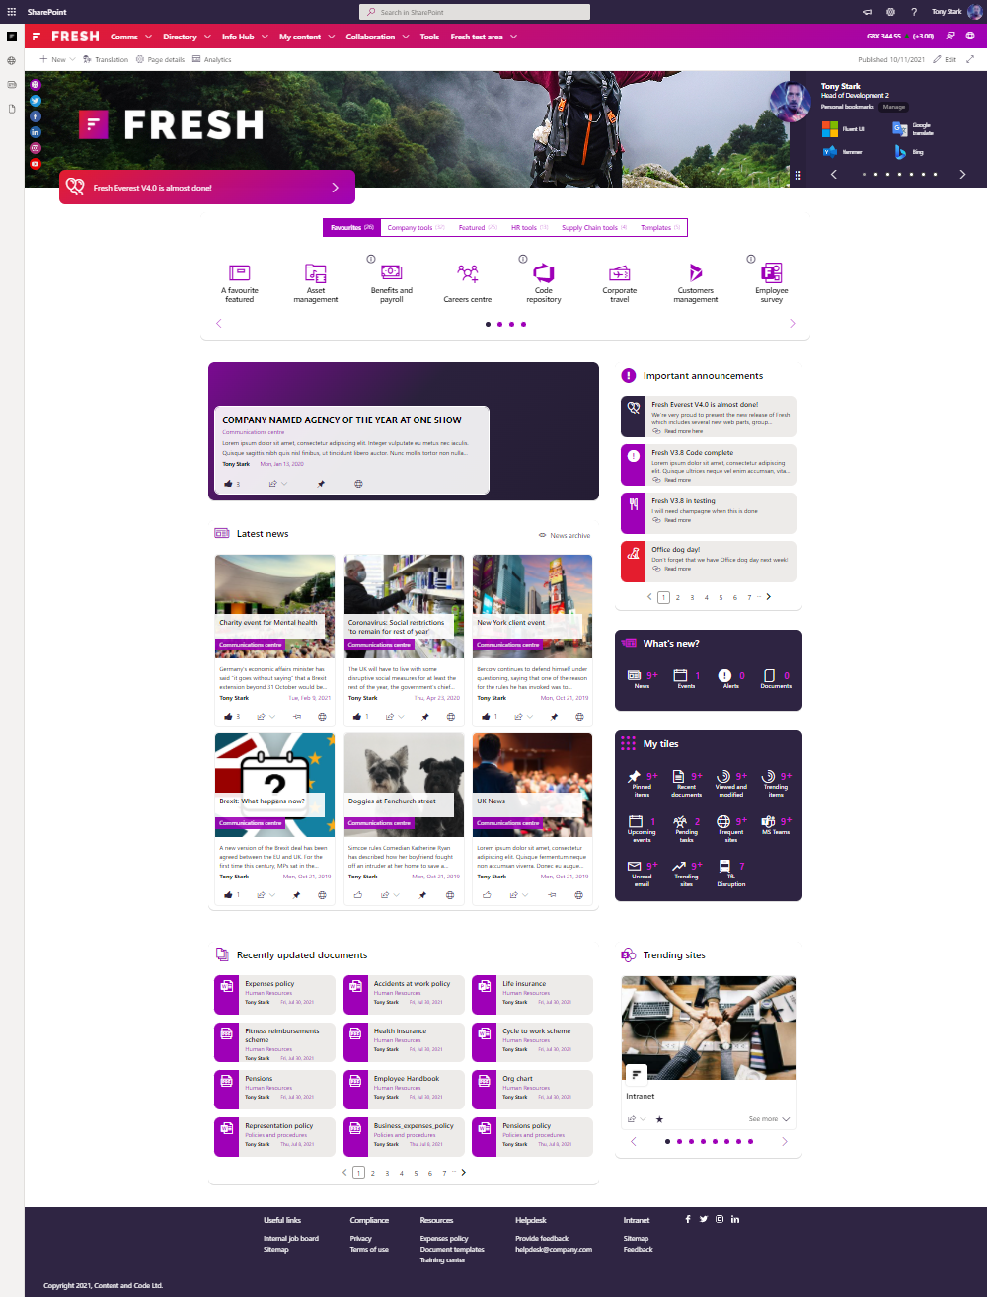
Intranet
Intranet* is the main building block that is deployed as part of a Fresh Intranet installation.
Contains the following components:
Intranet homepage
Tools list
Directories/Landing pages
Optional
Badges
Kudos
Feedback
* Required site in a Fresh Intranet installation.

Slide 7
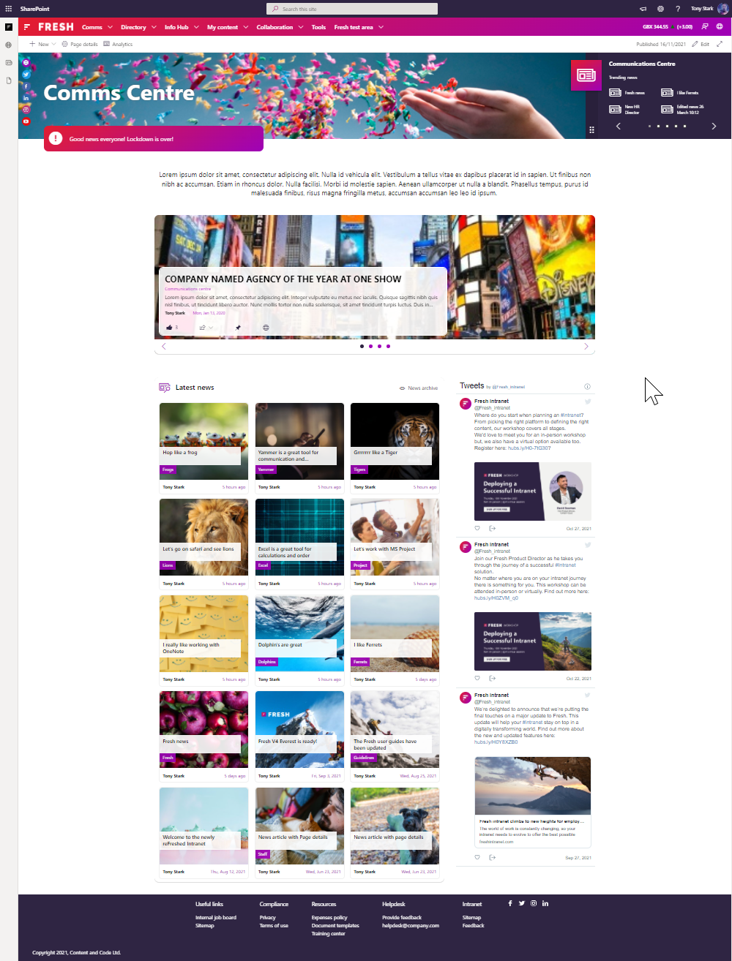
Comms centre
Comms centre* is a central place where the communication content can be created and managed.
Contains the three main components:
Alerts
Events
News
* Required site in a Fresh Intranet installation.

Slide 8
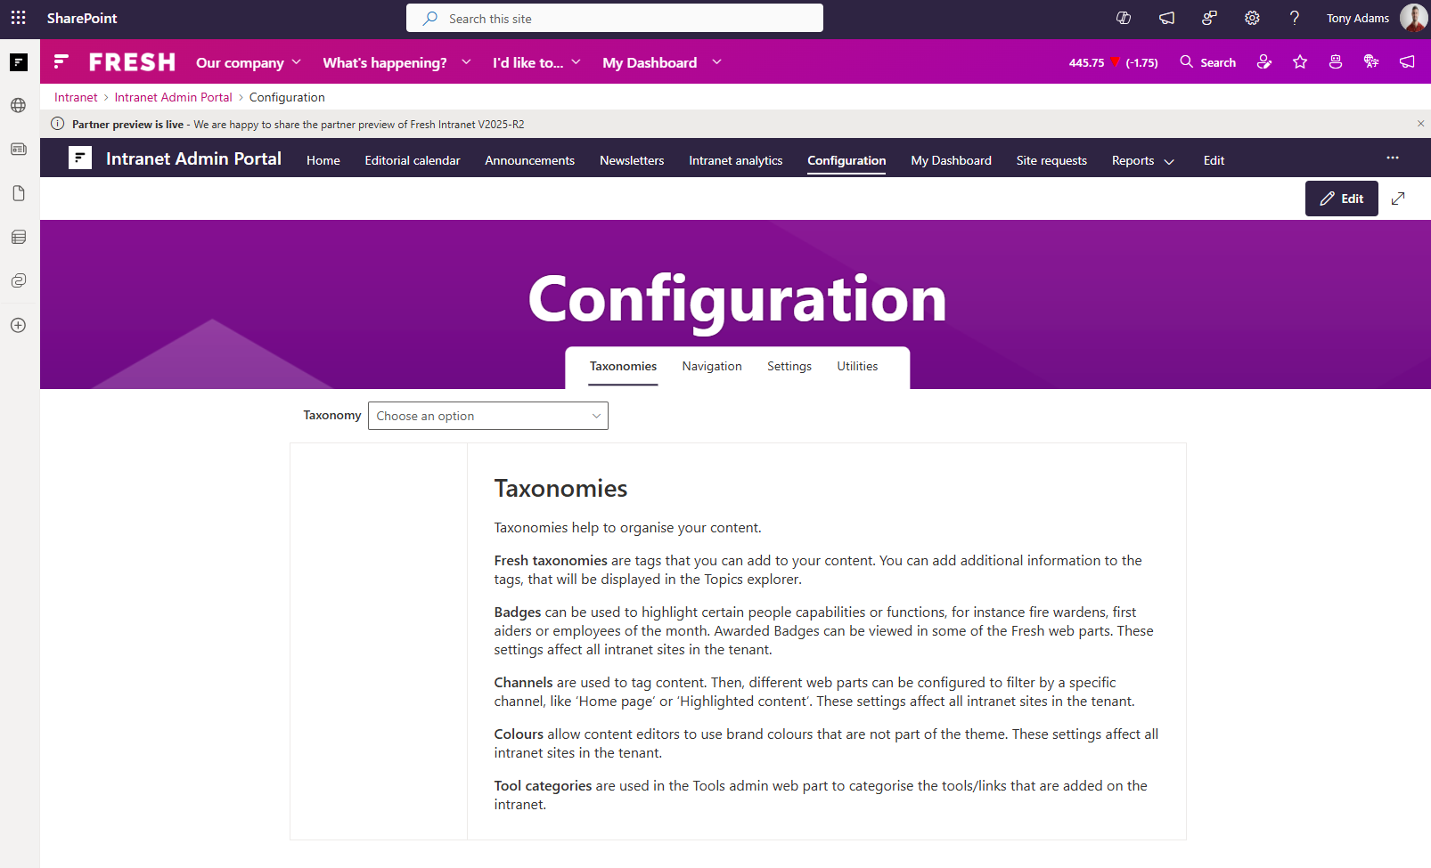
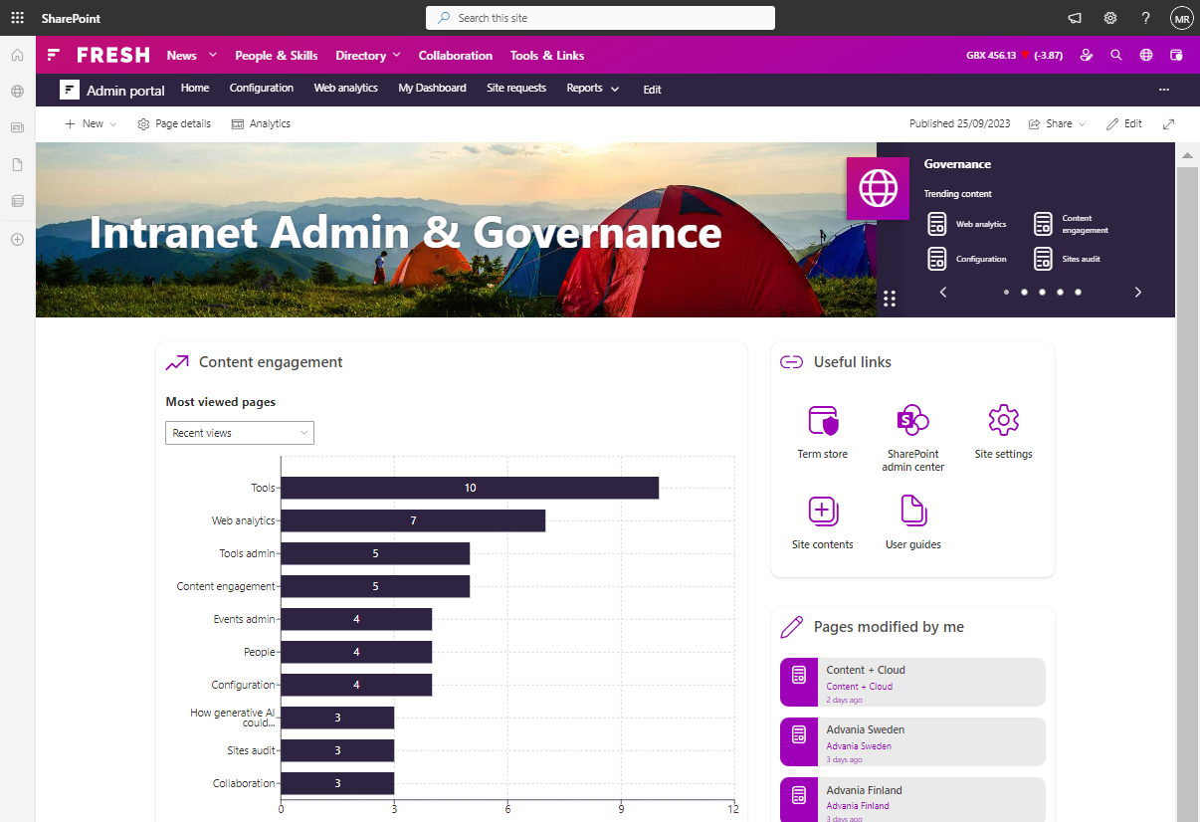
Admin Portal
Updated in V2025-R3
Use the Admin Portal* to manage the major Fresh configuration options and to understand how your content resonates with your intranet audience.
Contains the following components:
Configuration page: Taxonomies, Navigation, Settings, and Utilities.
Web analytics page: All page views, Peak time views, Tools, Engagement, Search, and Newsletter. (Optional and requires Azure)
* Required site in a Fresh Intranet installation.

Slide 9
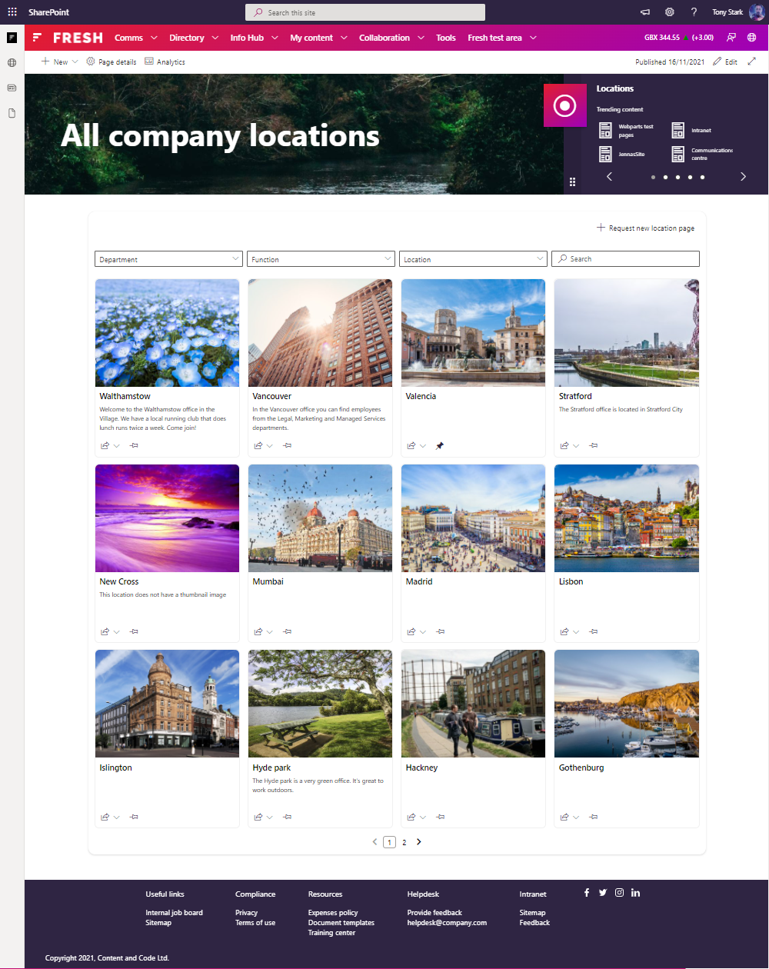
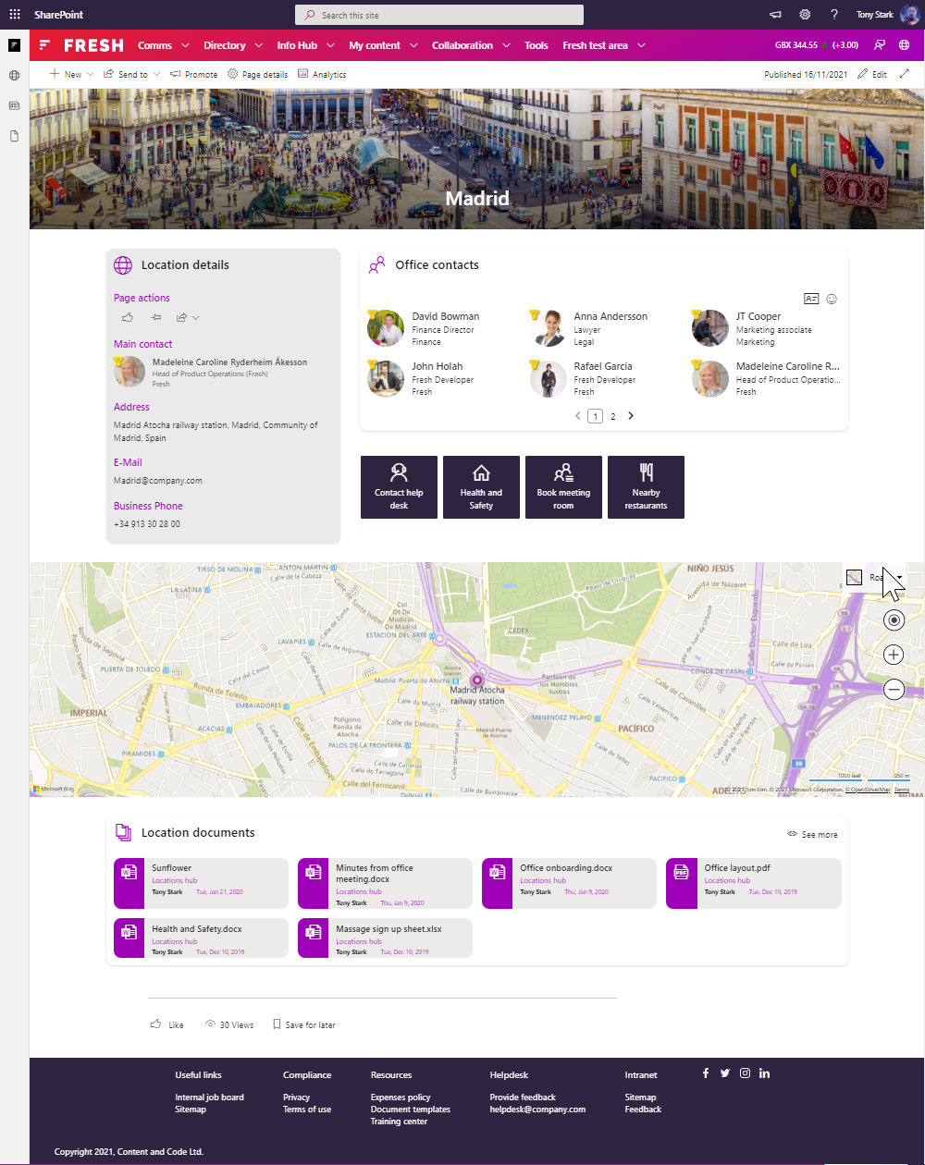
Locations
Use Locations* to share information about office locations, like nearby parking, how to book a meeting room and how to contact the office manager.
Rename "Locations" and modify its structure (PnP template) based on your needs.
Available as a template that users can request via provisioning.
* Optional built-in intranet scenario that can be deployed during a Fresh Intranet installation.

Slide 10
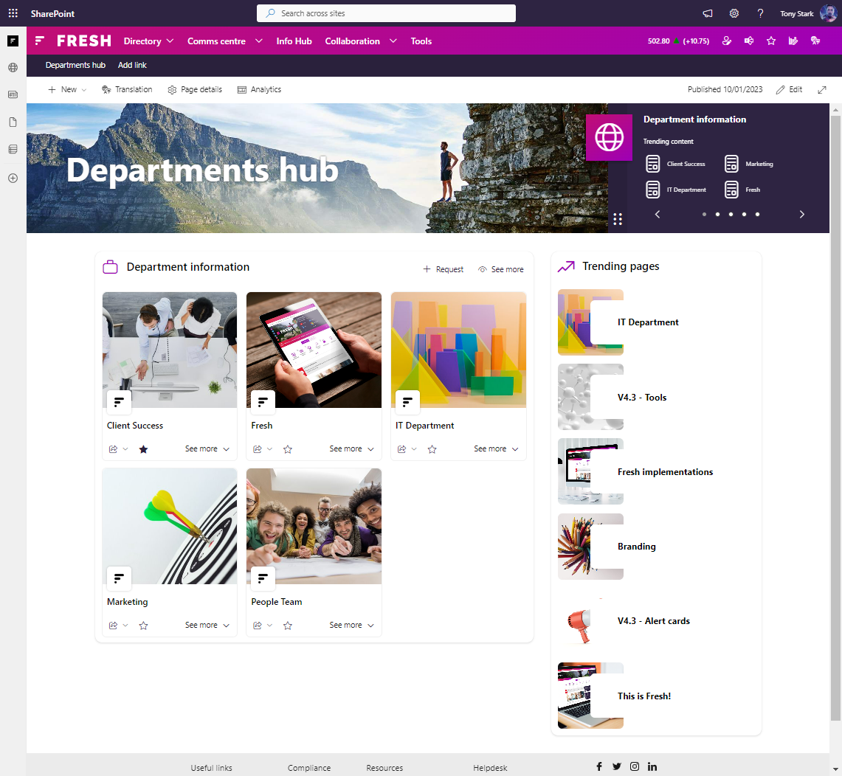
Department hub
Department hub* is a SharePoint hub site that serves as a central place for users to navigate to different department sites.
Rename "Department hub" and modify its structure (PnP template) based on your needs.
* Optional built-in intranet scenario that can be deployed during a Fresh Intranet installation.

Slide 11
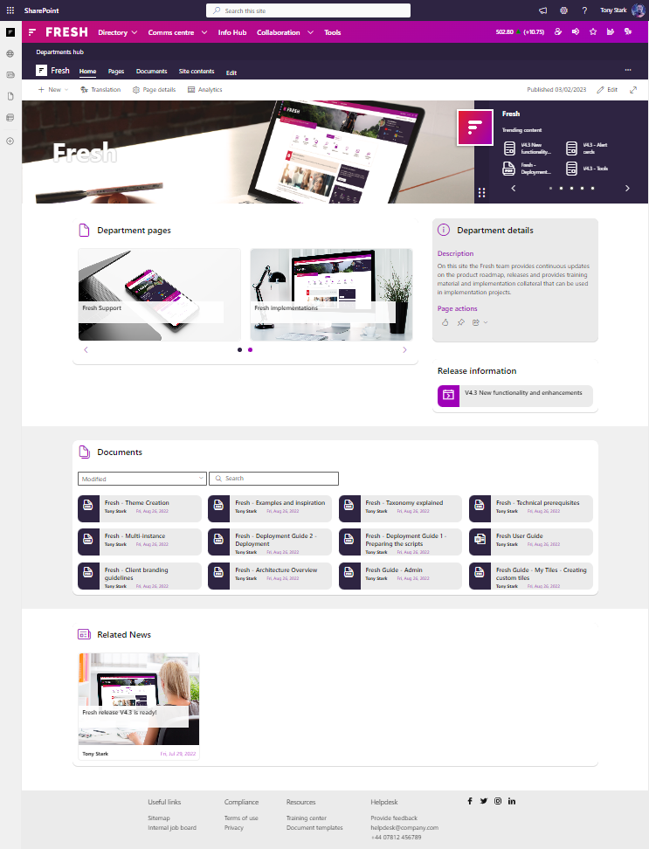
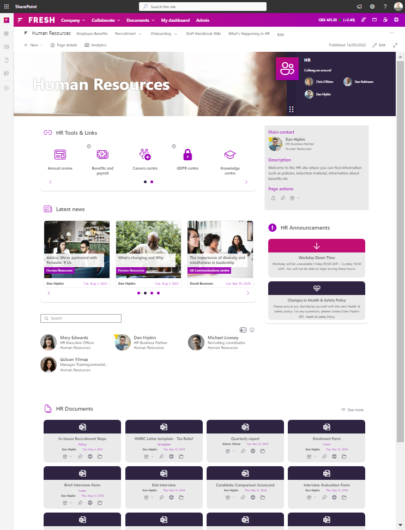
Department site
Use a Department site* to share information, documents, and links to enable users to find all the information they need in one place.
Rename "Department site" and modify its structure (PnP template) based on your needs.
Available as a template that users can request via provisioning.
* Optional built-in intranet scenario that can be deployed during a Fresh Intranet installation.

Slide 12
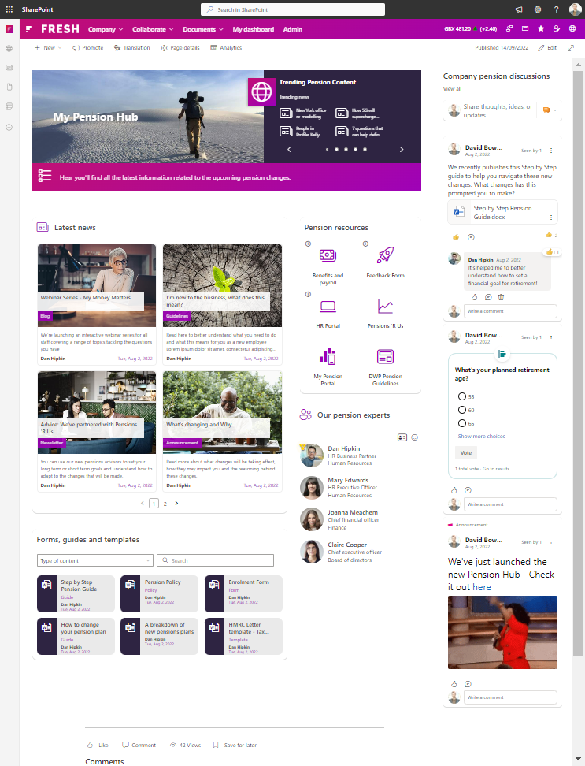
Content site
Use a Content site* to store information about the business units or organisational information such as policies, templates, values
Rename "Content site" and modify its structure (PnP template) based on your needs.
Available as a template that users can request via provisioning.
* Optional built-in intranet scenario that can be deployed during a Fresh Intranet installation.

Slide 13
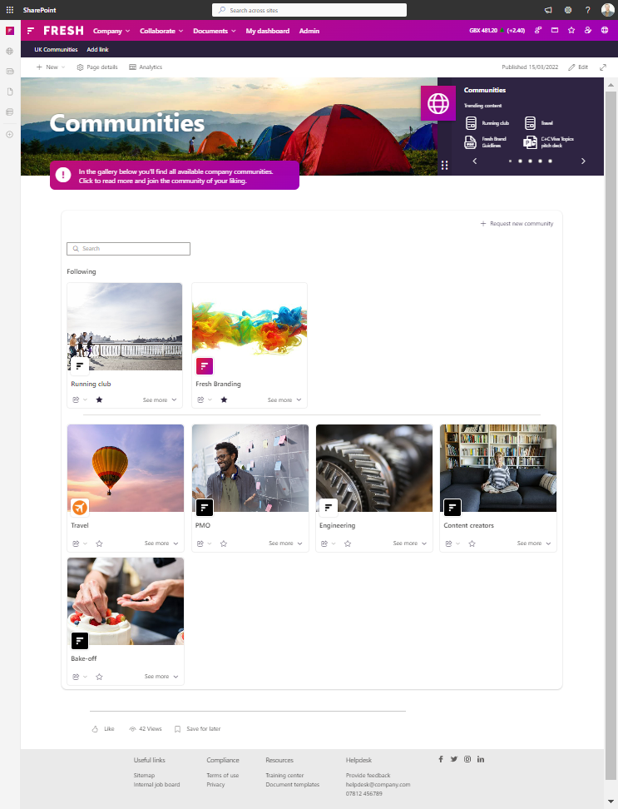
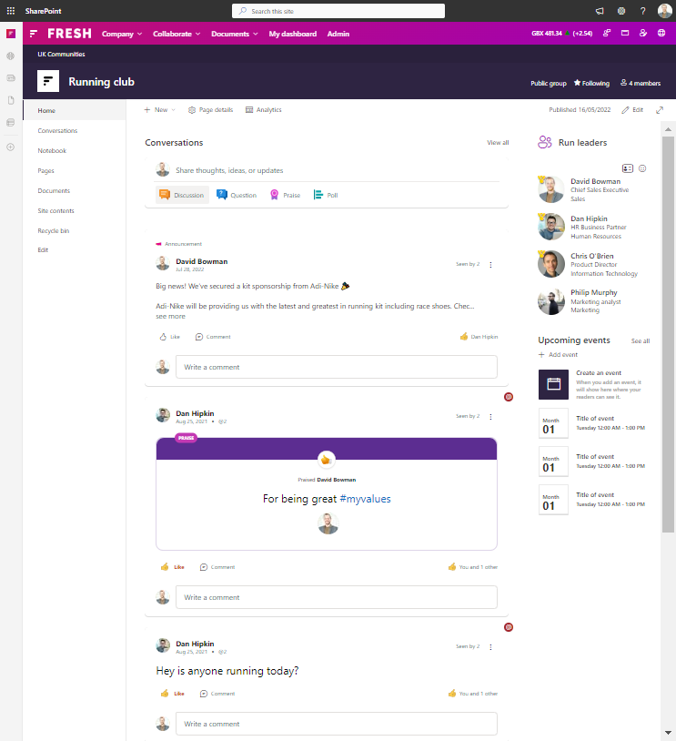
Communities
Use Communities* to enhance the employee community with topics-based collaboration and discussions on Viva Engage.
Rename "Communities" and modify its structure (PnP template) based on your needs.
Sites/Viva Engage communities can be requested and provisioned in line with the agreed template.
* Optional built-in intranet scenario that can be deployed during a Fresh Intranet installation.

Slide 14
Additional areas

Slide 15
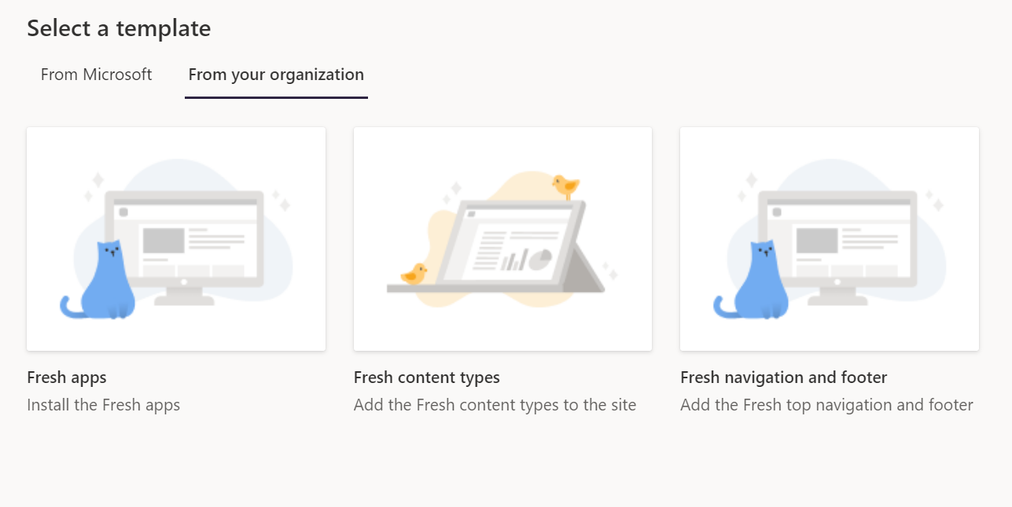
Freshify with site templates
3 site templates as option to add additional sites to the intranet
Fresh solution apps
Fresh content types
Fresh navigation and footer
Consideration
Templates are available on the whole tenant and is available to all site owners

Slide 16
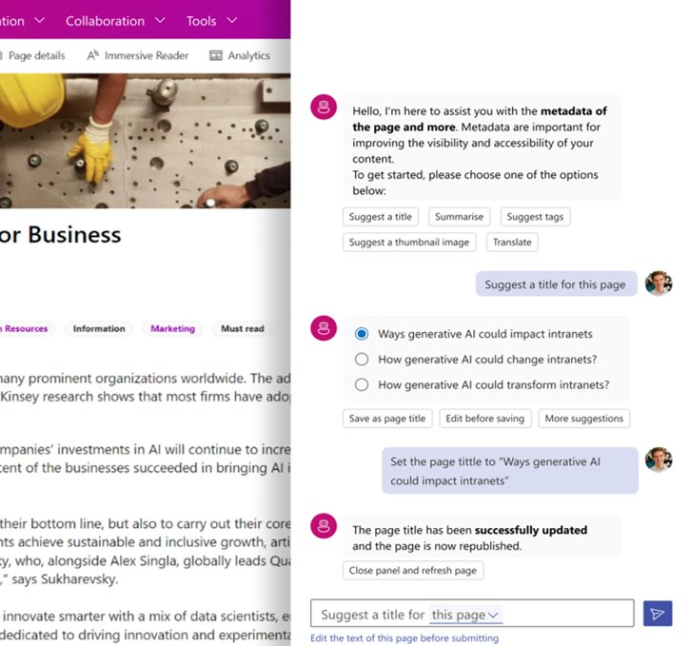
FreshMind
Introducing FreshMind, making generative AI work for you in your SharePoint intranet:
AI-driven people search, content (pages and documents) chat and more
Co-exists with Copilot for Microsoft 365
Designed for rapid adoption
Powered by Microsoft Azure OpenAI
Runs securely in your M365 environment

Slide 17
FreshMind – AI infusion into your intranet use cases
FreshMind
Content
editor
Content creation assistance
(Title, description, and keywork suggestion; translation & thumbnail generation)
Content management
AI-powered bulk update
(metadata and descriptions)
Finding information
AI-driven content chat (people, documents, and pages)
QnA bot in Viva Connections
Content chat based on scoped content
AI-driven content chat available from a search box
Content chat that respects user permissions (security trimming and audience targeting)

Slide 18
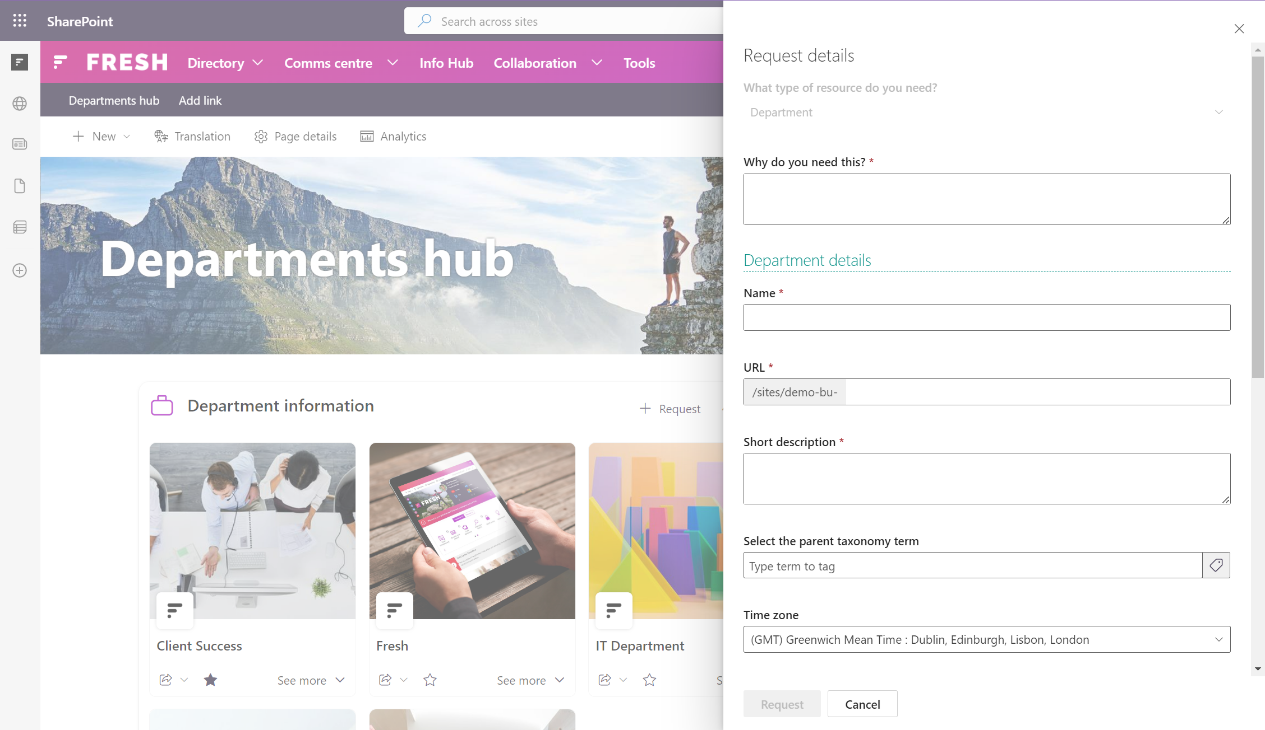
Provisioning
The provisioning module enables clients to create new sites and pages following the initial intranet implementation.
Configuration is available for approvers, default owners, members, and so on.

Slide 19
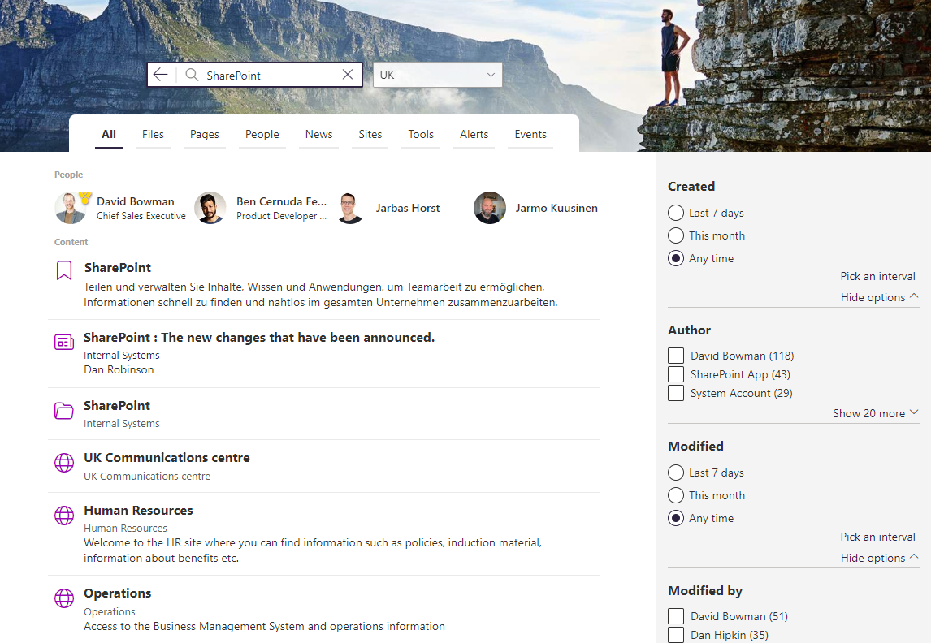
Search
Create a dedicated and extensive search experience, such as a Search Centre/Hub, for your intranet users.
Components: Search box, Seach scope, Search verticals, Search results, Search refiners, Search adaptive card (ACE)
Available via the Fresh global navigation in SharePoint and through our Fresh Search card in Viva Connections

Slide 20
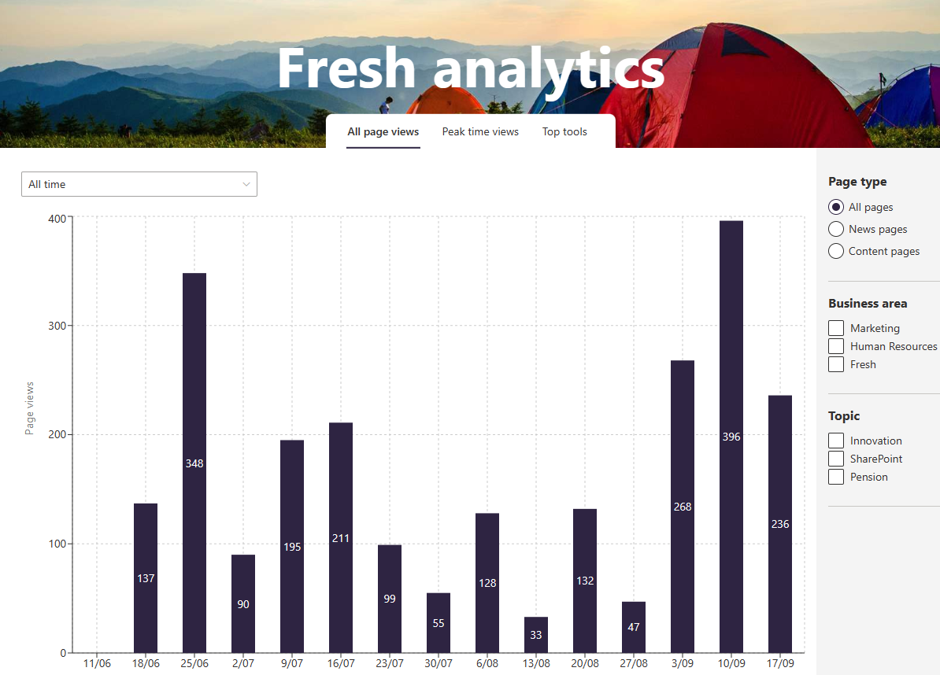
Web analytics
Fresh provides functionality which captures analytics data that can be further analysed using one of the following services:
Azure Application Insights
Fresh analytics
Google analytics
Google tag manager
Microsoft Clarity

Slide 21
Instances

Slide 22
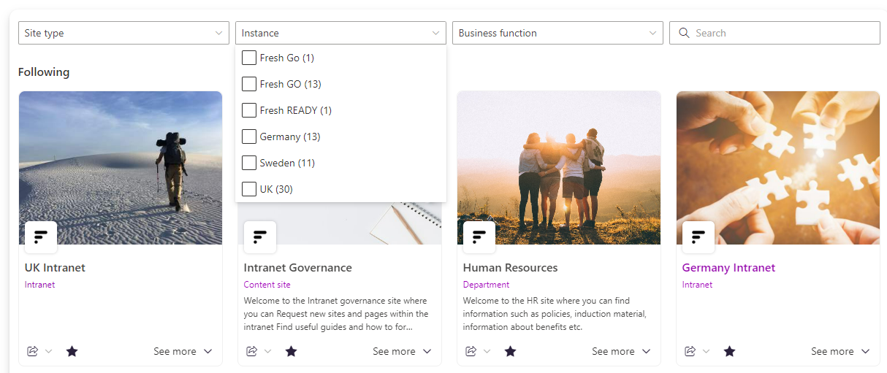
What is an instance and what’s it used for?
A set of sites connected via a URL prefix or hub site, plus an "Instance" label in property bag
The instance label is for example used in Site cards, so filters and labels can be done based on instance
Instance configuration
Global nav & Footer
Theme
Taxonomies
Provisioning entities
Search
Multi-instance
Most common is for clients to have one instance, but it is possible to have as many instances as you want.
Instances can have individual configuration of items outlined on the left.

Slide 23
Taxonomies and tagging

Slide 24
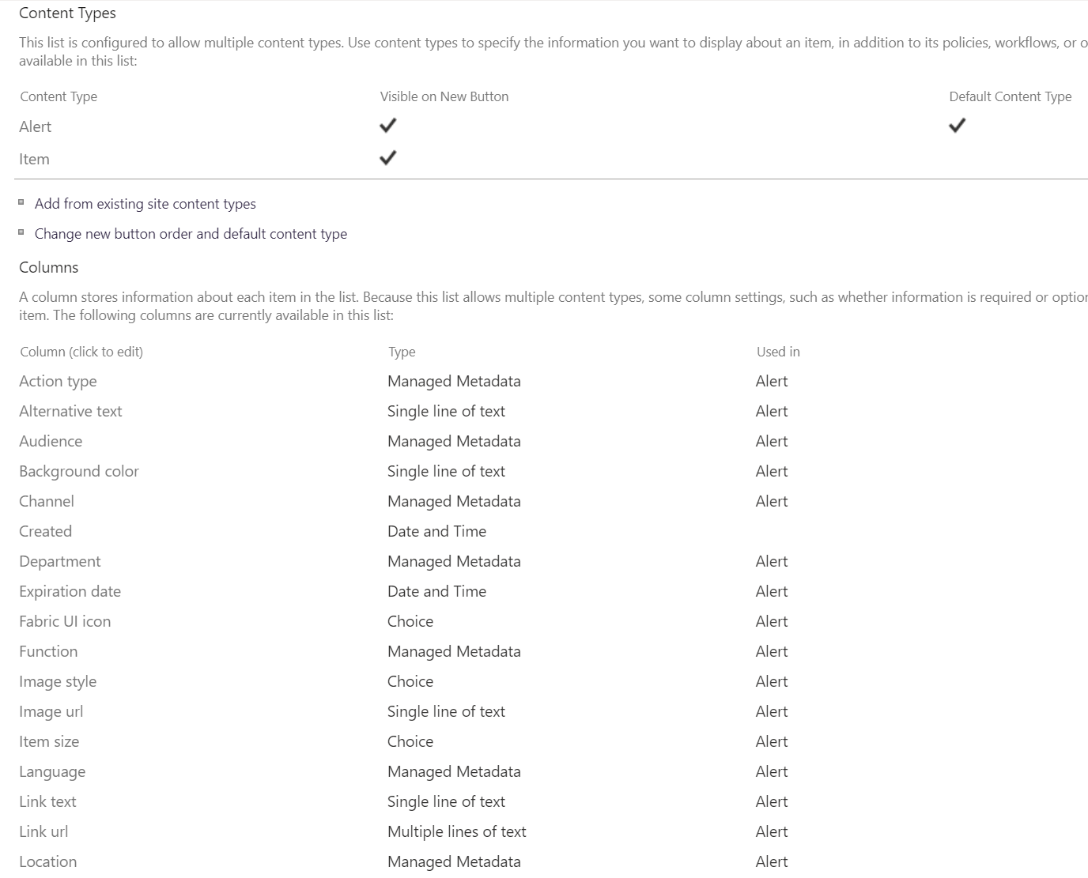
Content types
Fresh columns added to SharePoint page libraries
Fresh document
Fresh alert
Fresh event
Fresh tool
Provisioning entity content types

Slide 25
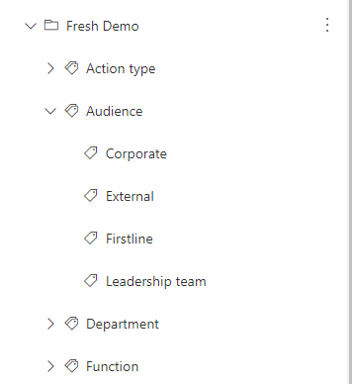
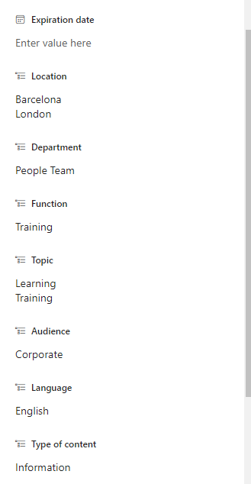
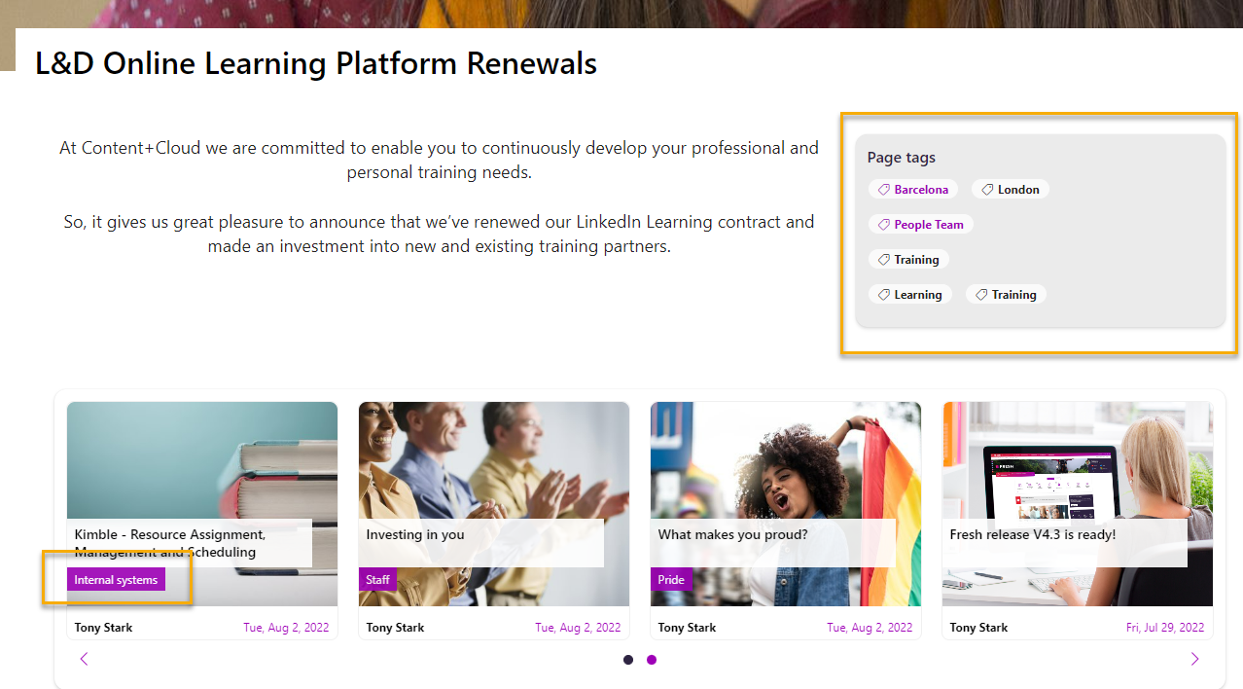
Taxonomies
Term store
Term sets with tags
Any number of taxonomies
Dependency on site column internal naming convention
Used in Fresh content types for tagging content
Used in Fresh web parts for display, refiners and queries
Item columns/
Content type
Fresh web parts

Slide 26
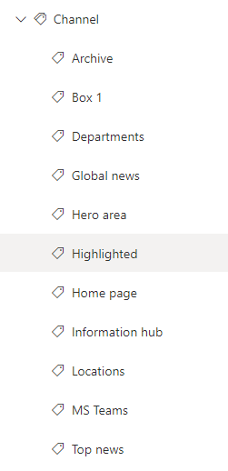
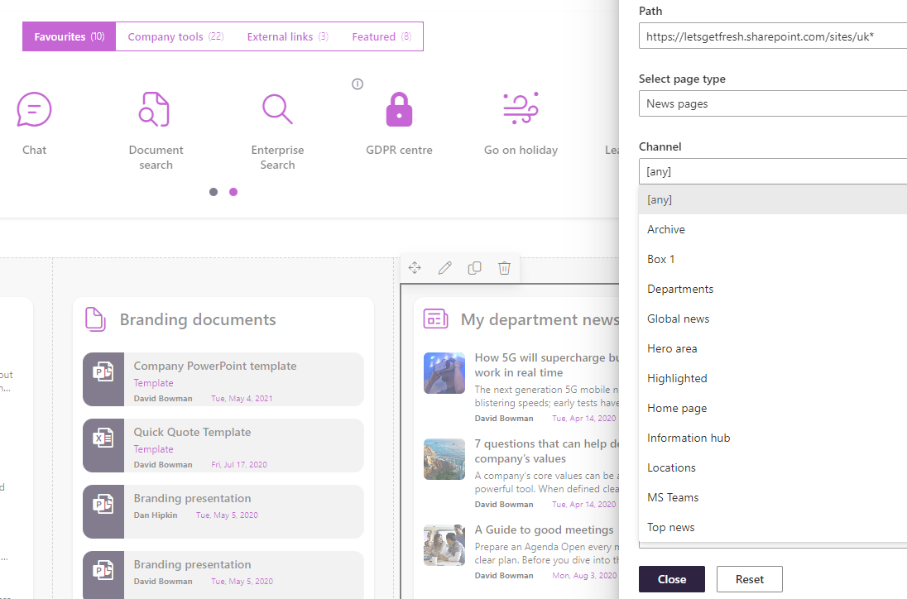
Additional tags - Channel
Tag used for easy filtering to decide which content should be displayed where, for example “Home page”, “Featured news”.
Managed in term store
Global settings

Slide 27
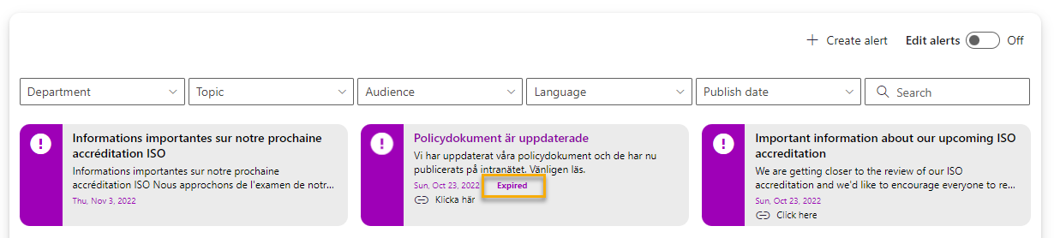
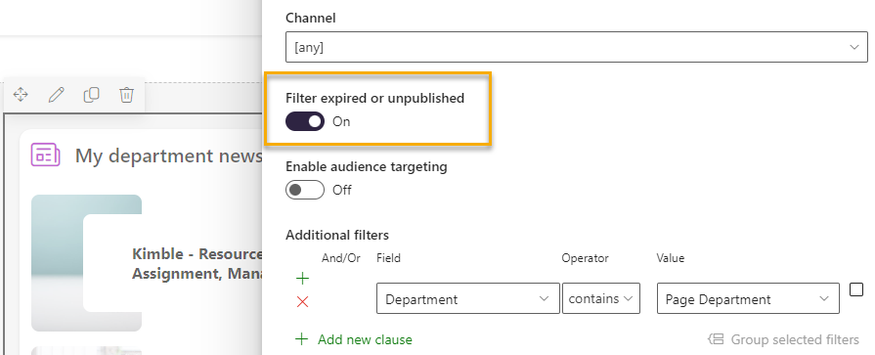
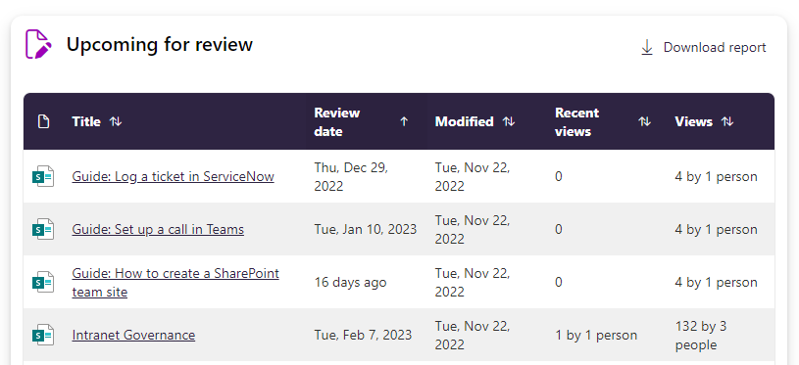
Additional tags - Dates
Publish date – Fresh specific publish dates which can help determine if a page should be displayed in web parts or not
Used for: Pages, Alerts
For full scheduling clients can use Fresh publish date together with SharePoint scheduling and approval flow.
Expiration date – Fresh specific date field which determines if an item should be displayed in a Fresh web part.
Used for: Pages, Alerts
Review date – Fresh specific date field used that is used in Governance web parts
Used for: Pages, Documents

Slide 28
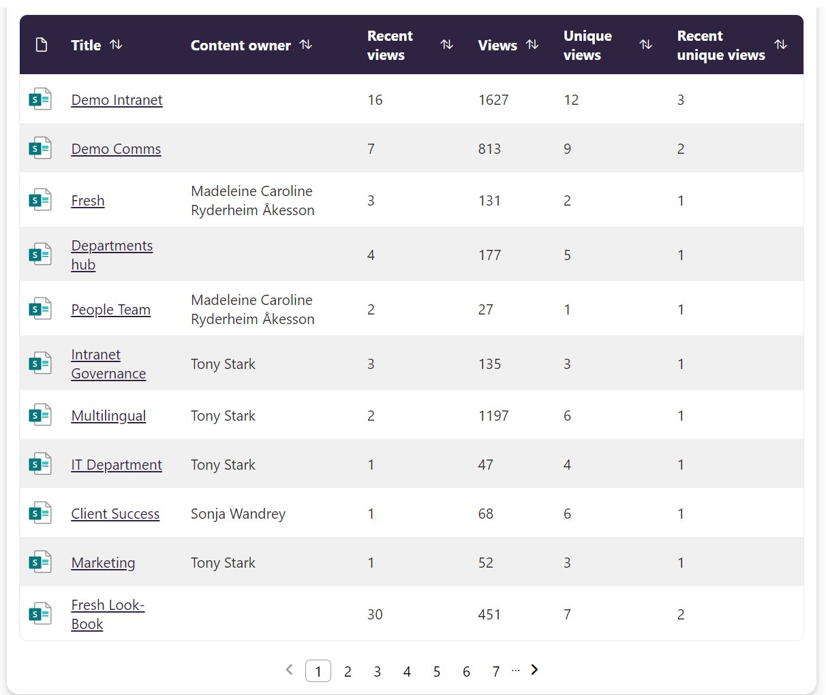
Content owner
Added to page and document content types
Available in cards web parts, but especially used in Governance web parts

Slide 29
Branding and styling

Slide 30
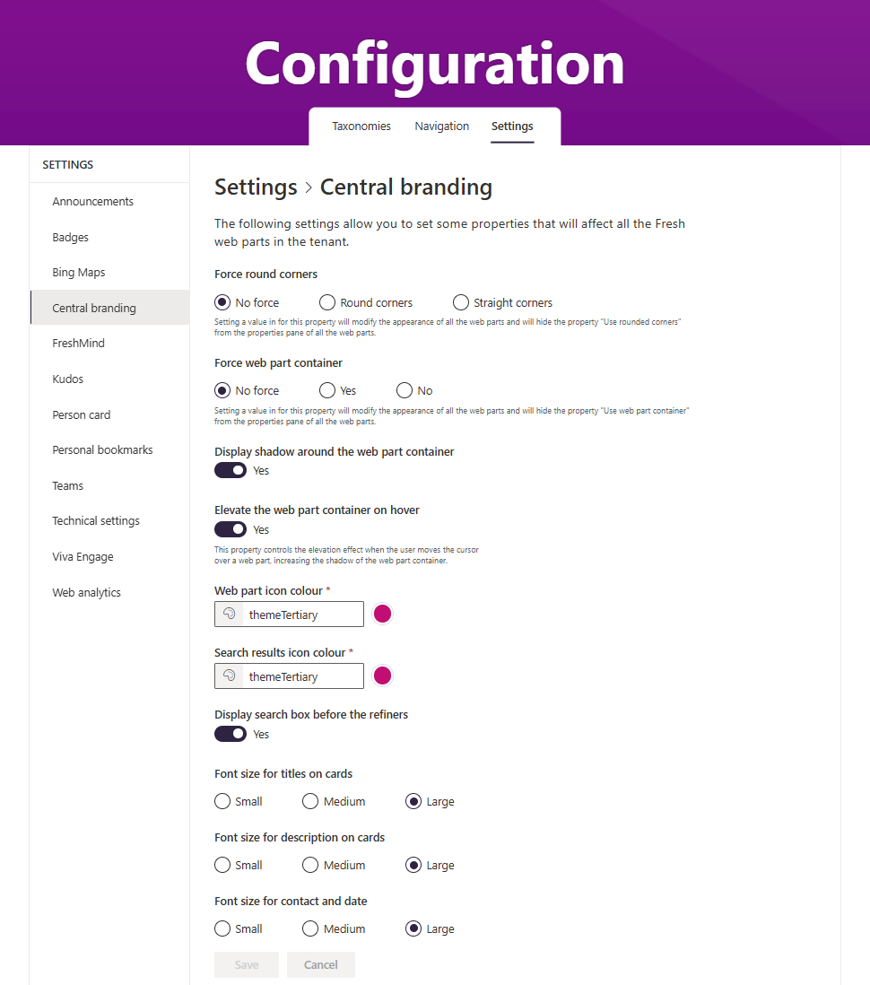
Central branding settings
Apply centralised branding settings to your intranet
Supports the following settings:
Rounded corners on/off
Web part container on/off
Web part container elevation on hover on/off
Web part container shadow on/off
Web part icon colour
Search icon colour (for Topics explorer, and on tenants that have the Fresh Search solution deployed)
Font size on cards web parts

Slide 31
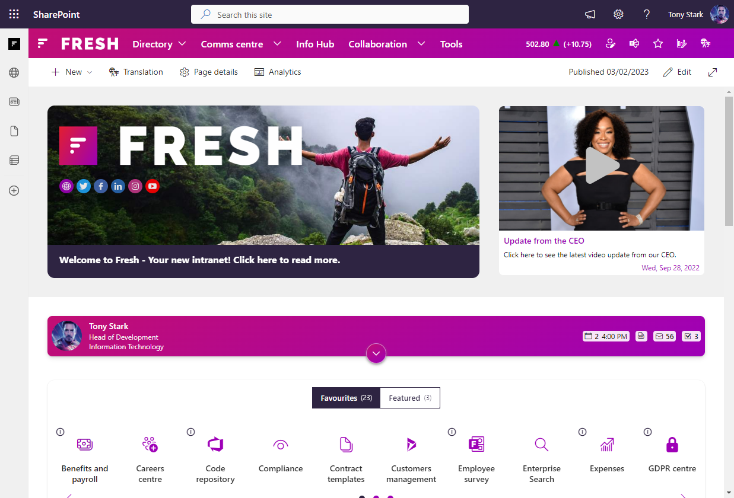
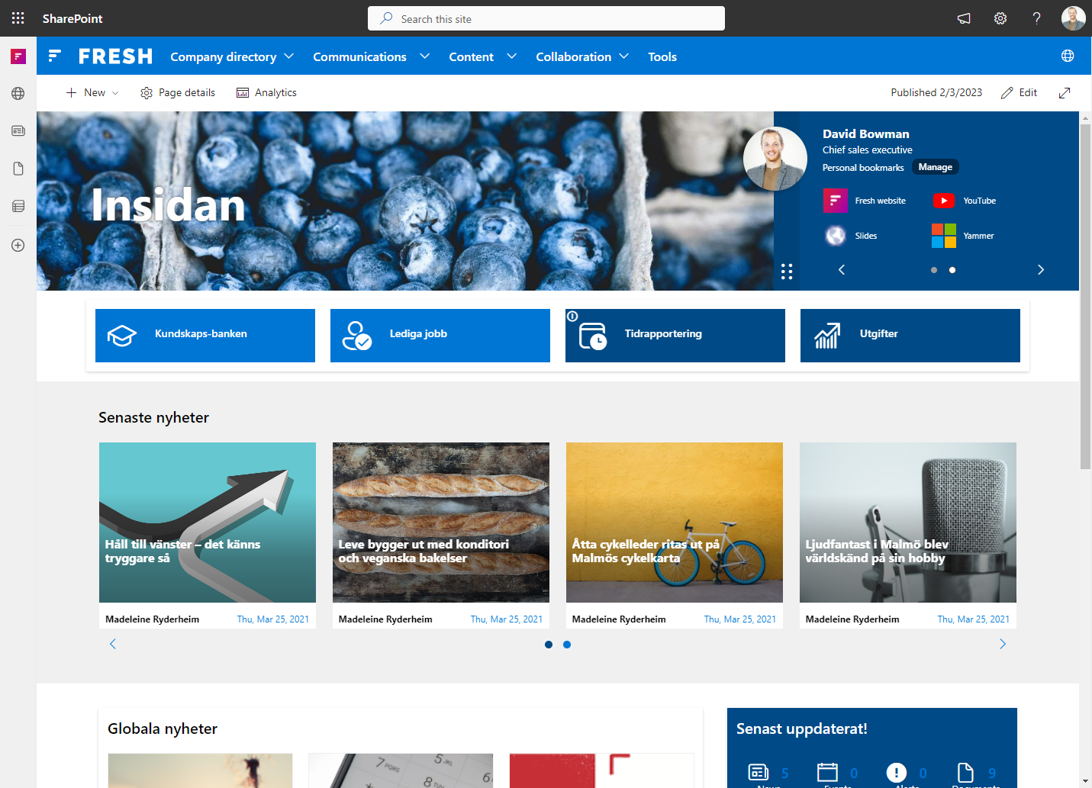
Theme
Fresh uses the SharePoint theme to set the colours on the intranet
During deployment preparation, the Theme is created in the Fluent UI Theme Designer and then ThemeSecondary, ThemeTertinary can be updated before deployment
ThemeSecondary and ThemePrimary amongst other theme slots are used across Fresh features

Slide 32
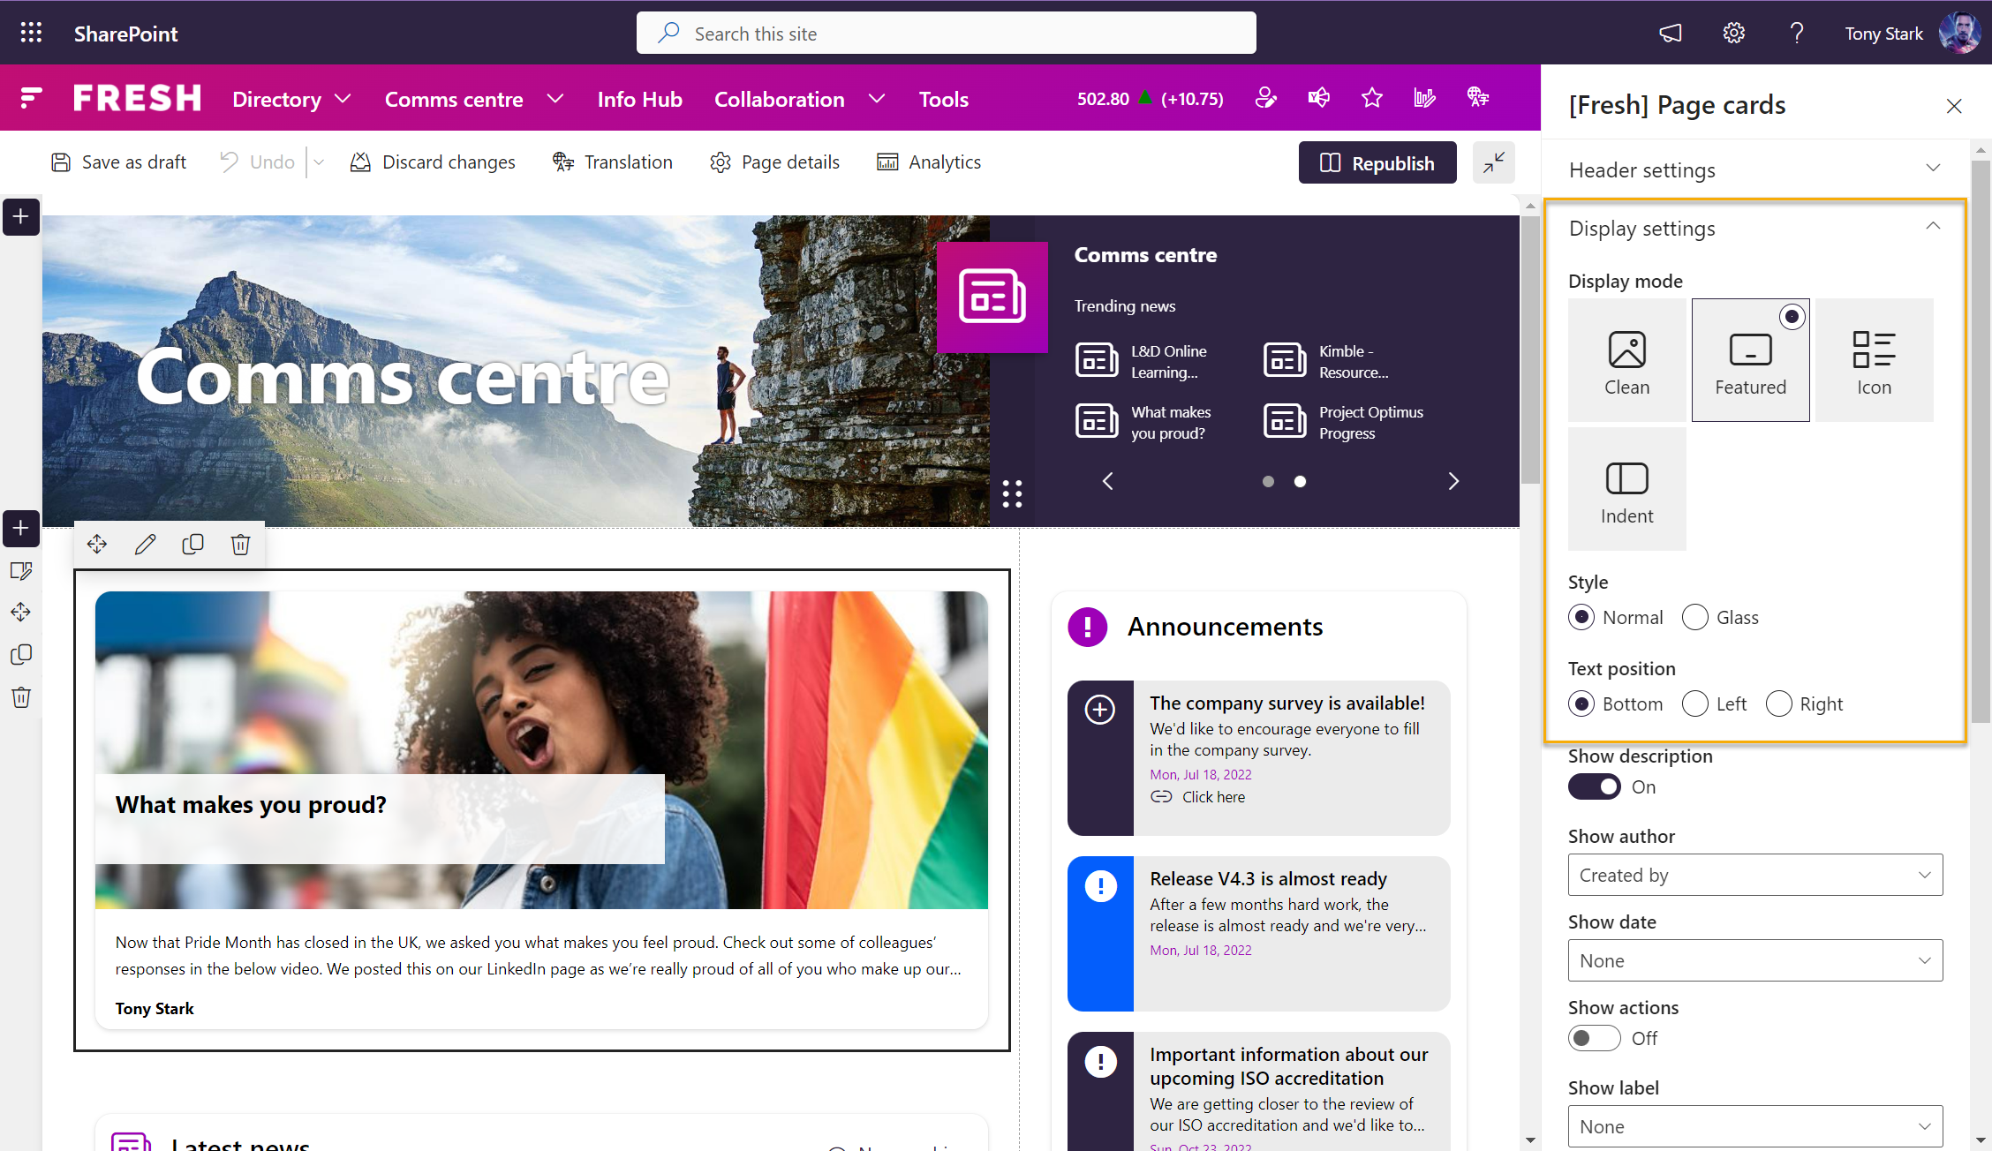
Display settings
Display settings are available to provide options for what to show and how to display it.
Display modes
Styles
Fields to display
Round corners
Colours
Default image
…

Slide 33
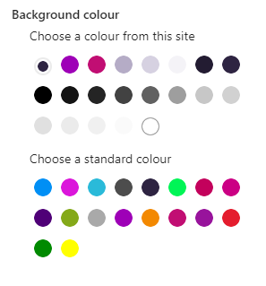
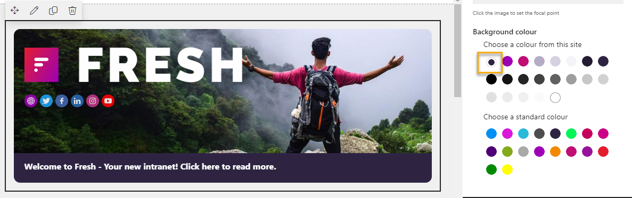
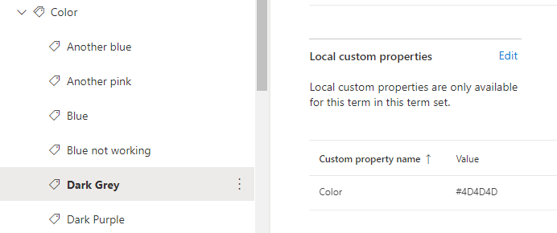
Colour picker
Fresh colour picker allows clients to select the colour to use in several features.
Colour from site – Theme colours
Standard colour – Custom client pallet configured in the term store
From site theme
From Color term set

Slide 34
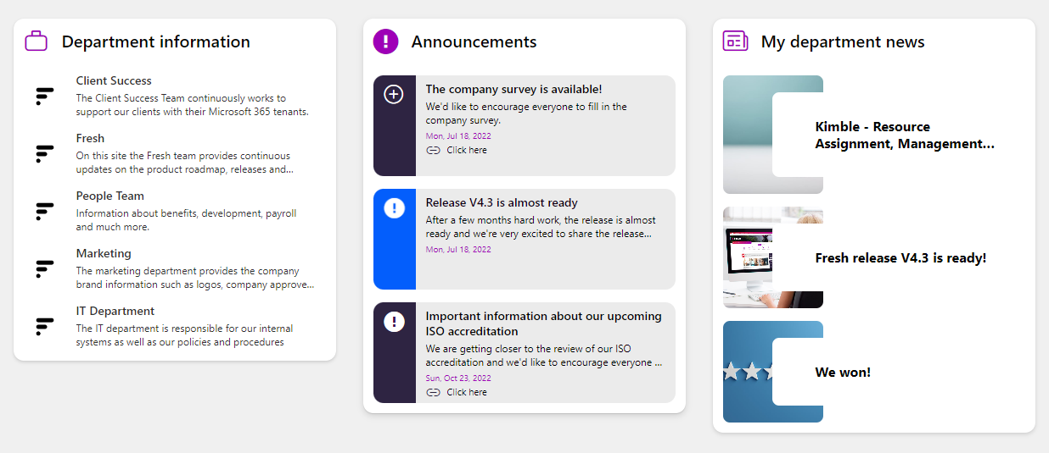
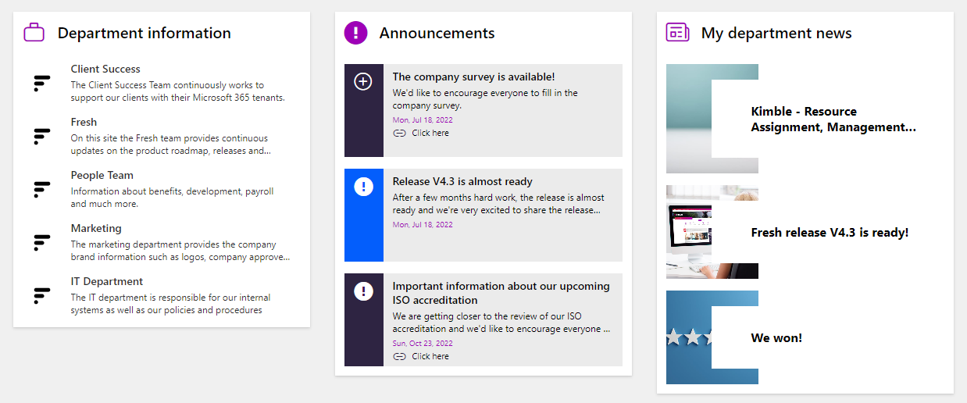
Round or straight corners
Most Fresh features provide display settings where clients can decide to use round or straight corners for their web parts
Default is "Round"
Can be set on web part level or global level for the tenant

Slide 35
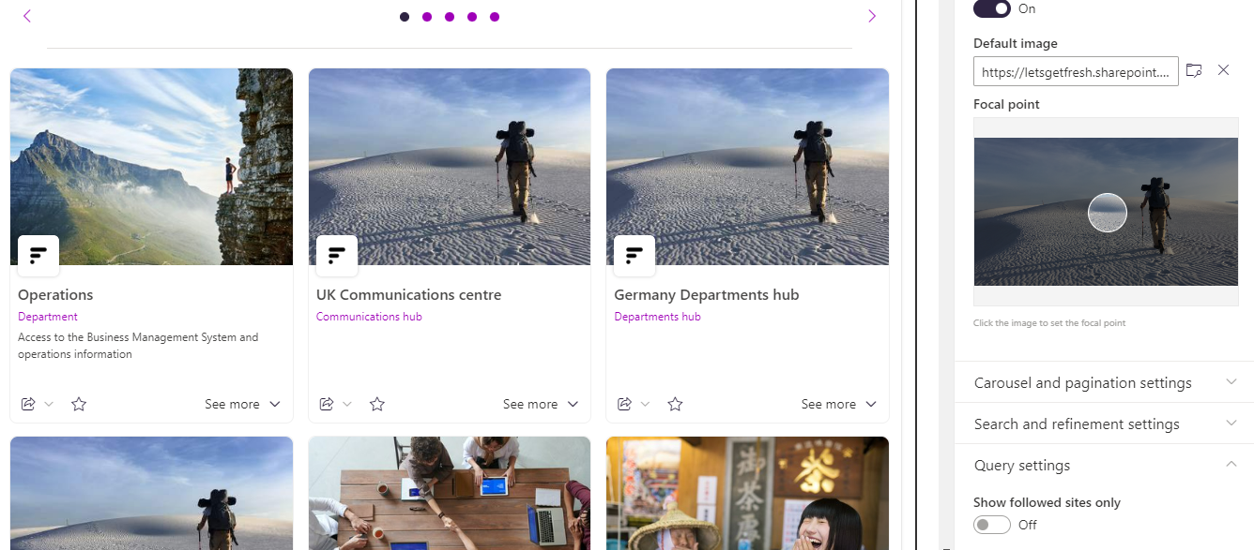
Default image & Focal point
For web parts where for example pages are displayed it is possible to add Default image, which is used when pages displayed in the web part does not return a thumbnail image.
In most cases, where images are added, the admin can choose the focal point for the image that is to be displayed.

Slide 36
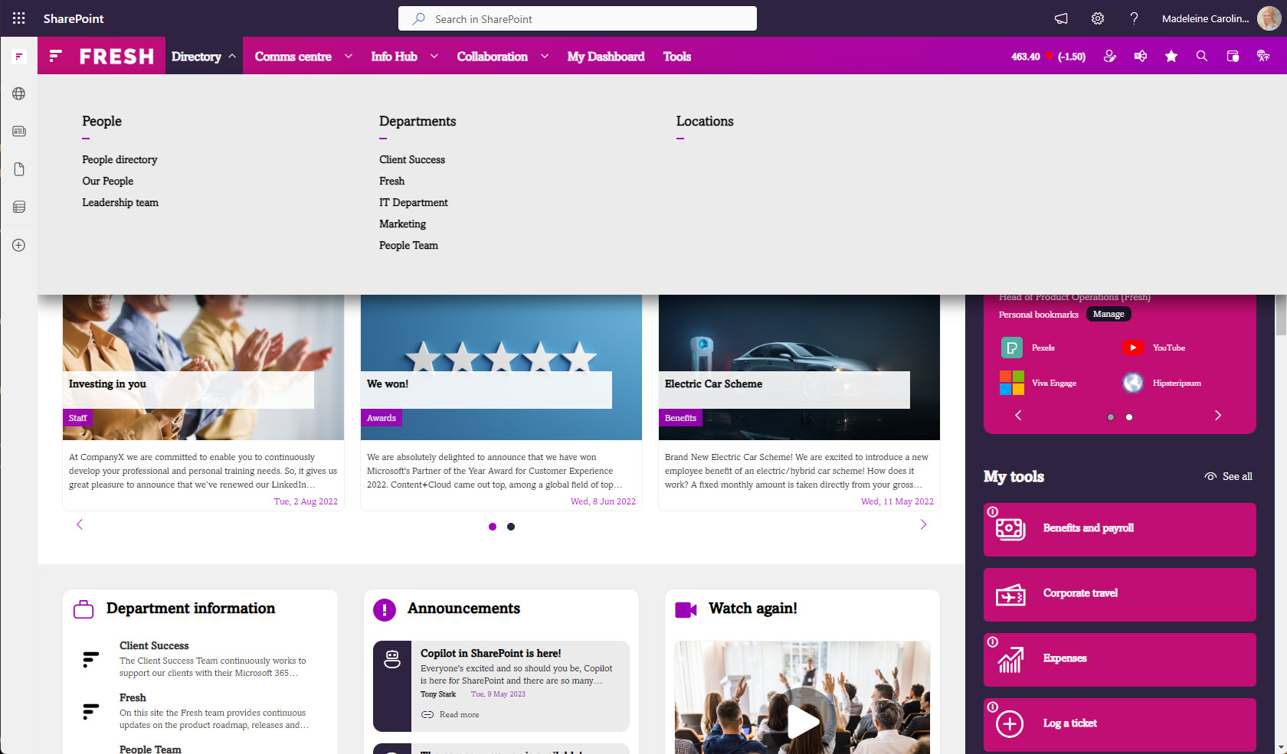
Support for custom fonts in SharePoint
Microsoft has introduced custom fonts via the Brand Center. Fresh automatically reflects a selected custom font on its web parts and components.

Slide 37
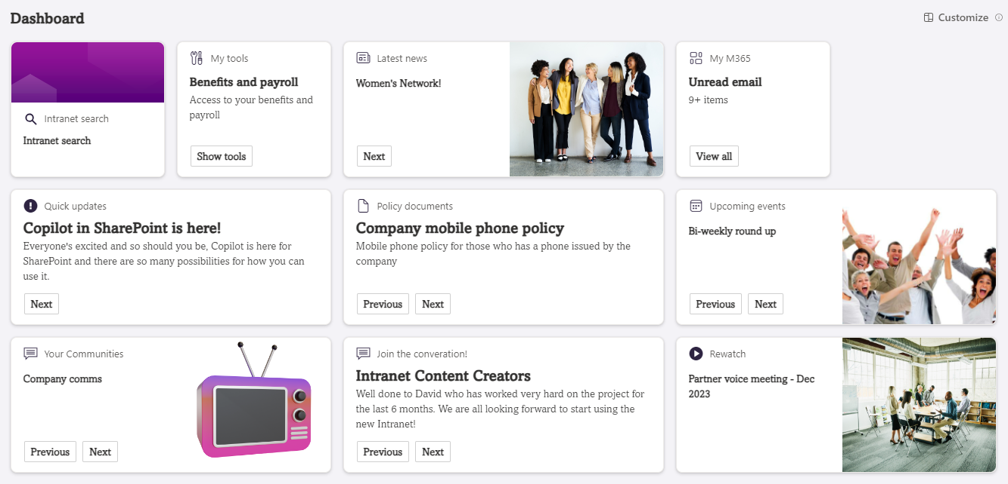
Support for custom fonts in Viva Connections
Microsoft has introduced custom fonts via the Brand Center. Fresh automatically reflects a selected custom font on its Viva Connections cards and components.

Slide 38
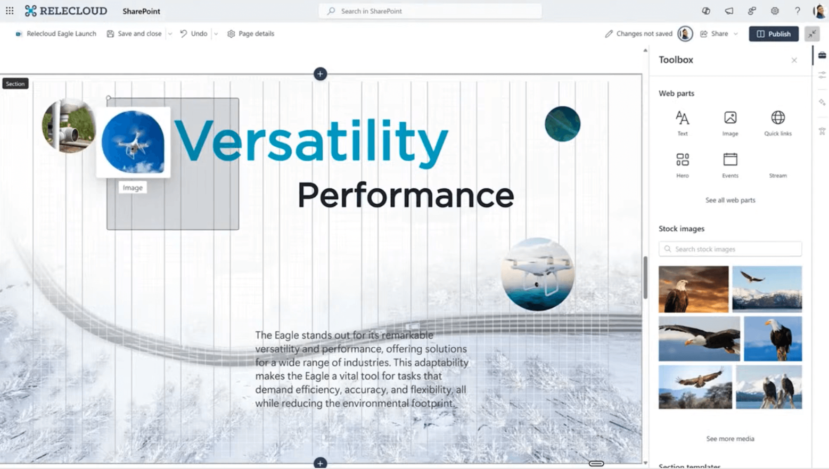
Support for flexible layout sections
Use Fresh web parts in flexible layout sections on SharePoint pages.
Resize, overlap, and move web parts to create visually appealing content.

Slide 39
Navigation

Slide 40
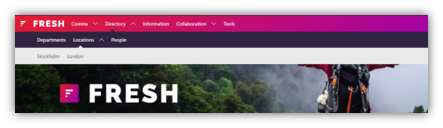
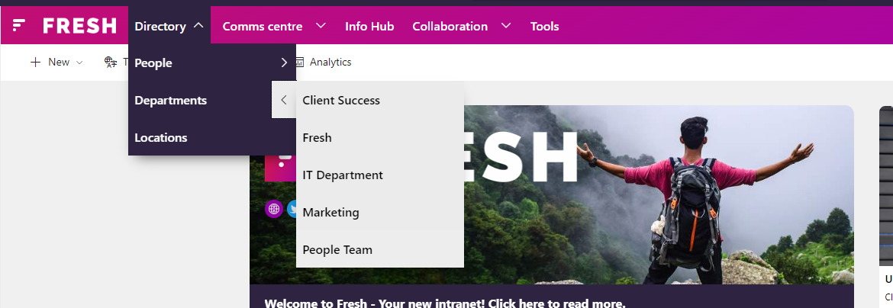
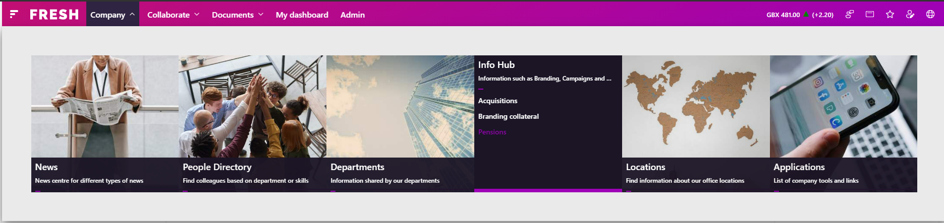
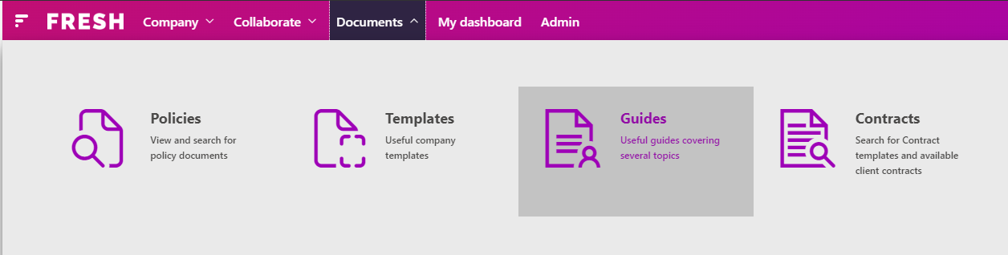
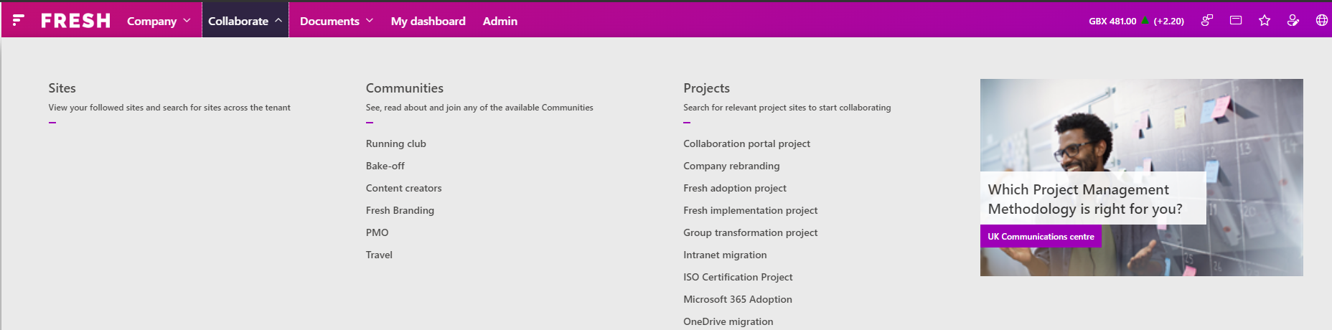
Global navigation
3 main display options
Horizontal
Cascading
Mega menu

Slide 41
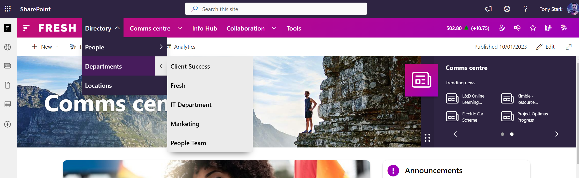
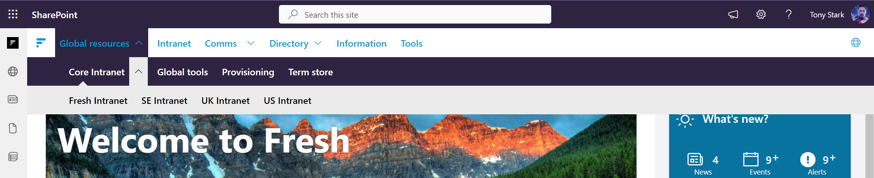
Example configuration options
Navigation colours
1st level with/without gradient
3 levels background/text colour
3 levels background/text hover colour
Icon colour
Opacity for level 2 and 3 in cascading
Audience targeting
On-hover text for navigation items

Slide 42
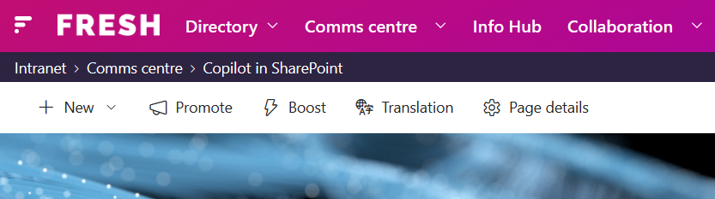
Global navigation - Breadcrumbs
Displays automatically up to six navigation levels on all pages on the intranet.​
Enable the breadcrumbs to enhance intranet navigation by providing a clear, efficient path for users to understand and navigate the site's hierarchy.

Slide 43
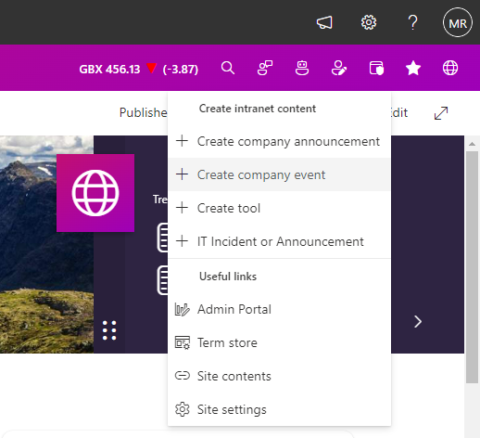
Global navigation apps
Share price powered by Investis
User profile
Custom link
Follow site
Feedback
Translation functionality (See Multilingual)
Admin panel
Search
Content editor assistant
Notifications

Slide 44

[Navigation] – Admin panel
Kick-off the creation of alerts, events, and tools from a central place.
Create multiple sections to better structure your use cases.
Create and target links to specific users in your organisation.

Slide 45

[Navigation] – Content editor assistant
Start the AI-powered content editing assistant app for support with your content creation experience.
Choose from title generation, to page summary creation, and metadata suggestion. Use the app to create thumbnail and banner images as well as for content translation.

Slide 46

[Navigation] – Custom link
Define the icon and text of your custom links.
Add links to internal and external content such as your own feedback form, the company web site, or the intranet's FAQ.

Slide 47


[Navigation] – Feedback
Gather user feedback about the entire intranet portal, a site, or specific page.

Slide 48


[Navigation] – Notifications
Access targeted notifications centrally through the global navigation on your intranet.

Slide 49
[Navigation] – Share Price powered by Investis
Keep your intranet users up-to-date and display share price information on the intranet.

Slide 50
[Navigation] – Search
Kick-off a search from the global navigation.

Slide 51

[Navigation] – User profile
Access to the org cart from the user profile.
View and edit your user profile properties such as skills and interests. Plus, access your favourite apps, see your badges, and more.

Slide 52

Footer
1 Footer per instance
2 level navigation
Social media icons – optional
Provides colour configuration options in term store

Slide 53
Multilingual

Slide 54

Auto translate
Translates textual content on the page to the current user’s translation language
Azure Cognitive Services
Custom user profile property – Translation language
Users can choose translation language or it can be set for them

Slide 55


Translated product labels
Set labels in code supports the following languages:
Czech
Dutch
English UK
English US (default)
Finnish
French
French (Canadian)
German
Polish
Spanish
Swedish
Turkish

Slide 56


Translated navigation
Navigation links can be translated in the term store and are displayed in the end user’s set display language

Slide 57



Translation of tags and taxonomy headings
Functionality which allows Clients to translate “Site column names” and tags to other languages, which are then displayed in the end user’s display language in Fresh features such as Refiners, Page details and more.

Slide 58



SharePoint page translation
Using SharePoint page translation, Fresh features displays the translated pages (if available) based on the current page’s language, for example, on a French page, it will show pages translated to French.

Slide 59
Personalisation

Slide 60

Custom user profile properties
Custom properties are deployed to allow enhanced personalisation in Fresh features.
Additional properties can be created and used based on Client specific requirements

Slide 61
Profile panel
Connected to the user’s profile, it can be configured to display useful information to the user, as well as allow users to edit information such as skills and interests.
If enabled, users can see information about their colleagues in the same panel from features such as People search and Page details.

Slide 62

Favourite tools
Using Tools admin, end users can choose their favourite tools, which can be displayed in other tools web parts such as Tabbed tools and Tool cards.

Slide 63

Profile property targeting
The Query builder in search-based card web parts can be configured to display content based on end user profile information, for example where the user’s department or location matches the tag set on an item.

Slide 64


Audience targeting
Using group targeting to ensure the correct audience is seeing the content.
Use it on:
Pages
Documents
Alerts
Events
Tools

Slide 65

Followed sites
Users can follow sites using out-of-the-box SharePoint functionality or in Fresh features such as global navigation or web parts such as Site cards.
Followed sites can be highlighted in Sites web parts and the web part can also be configured to only display followed sites.

Slide 66



My profile
Web part focused on the current user, displaying content such as
Badges
Kudos
Interests
Skills
Personal bookmarks
Frequent sites
Configured to display only relevant sections

Slide 67
Teams

Slide 68

Fresh Teams intranet app
New in V2025-R3
Provide individual landing experiences (e.g., home page, department page, and a news post) for employees.
Access the intranet from Microsoft Teams without using Viva Connections.

Slide 69


Announcements in Teams
Receive messages in the Teams mobile app.
Receive messages in the Teams web or desktop client. For more information, see [Announcements] – Announcements in Teams.

Slide 70
Viva Connections Cards (ACEs – Adaptive Card Extensions)

Slide 71



Fresh ACEs for Viva Connections
Fresh ACEs are available on the mobile and desktop versions of Viva Connections.
Choose from 14 different Fresh ACEs to complete your Viva Connections dashboard.

Slide 72


[AI] – Q&A bot
Answer can be based on people and intranet content, such as pages and documents.
Create scope-based Q&A chatbot experiences that can be targeted to different audiences.
Reference links to source content used in the bot answers.

Slide 73


[Alerts] – Alerts ACE
Bring time-sensitive information to your intranet users in Viva Connections.

Slide 74


[Cards] – Curated documents ACE
Open documents natively in the Viva Connections experience.
Display a manual selection of documents for a specific business scenario, such as policies, in Viva Connections.

Slide 75



[Cards] – Curated pages ACE
Open documents natively in the Viva Connections experience.
Display a manual selection of content pages (or news posts) for a specific business scenario in Viva Connections.

Slide 76


[Cards] – Page cards ACE
View and access your intranet pages or company news within the comfort of Viva Connections.

Slide 77
[Cards] – Document cards ACE
Build custom queries to display documents based on file extension, document metadata, and more.
Open documents natively in the Viva Connections experience.
Display documents in Viva Connections with support for audience targeting based on user profile properties.

Slide 78


[Community] – Viva Engage communities ACE
See recent conversations within the card.
Display one or more Viva Engage communities in Viva Connections to increase their visibility.

Slide 79



[Community] – Viva Engage conversations ACE
Choose from five selection modes to display conversations based on your business scenario.
View and access conversations from one or more Viva Engage communities in Viva Connections.

Slide 80


[Events] – Event card ACE
Add events to your Outlook calendar from the comfort of Viva Connections.
Display one-time and recurring events in Viva Connections to increase their visibility.

Slide 81


[Media] – Video card ACE
Display a selection of one or more videos from your intranet in Viva Connections.
Watch videos in Viva Connections without context switching.

Slide 82


[Personalisation] – My data ACE
Show information related to the signed-in user based on their Microsoft 365 data.

Slide 83



[Personalisation] – What’s new ACE
Open the content natively in the Viva Connections experience.
Show recently created or modified content for news, events, alerts, documents and content pages.
Quickly catch up on any news or other updates that have happened while you were away.

Slide 84

[Search] – Search box ACE
Consistent search experience across SharePoint and Viva Connections.

Slide 85

[Tools] – Tools ACE
Show company tools and links in Viva Connections.

Slide 86
Admin features

Slide 87

[Analytics] – Peak time views
Refine your analysis by time frame (incl. all time), page type (e.g., news posts or content pages), and user/page properties.
Understand the time of day when users are accessing the intranet.

Slide 88

[Analytics] – Top Tools
Refine your analysis by
time frame (incl. all time) and user properties.
Understand the top 10 tools that are used in the intranet.

Slide 89

[Analytics] – All page views
Refine your analysis by time frame (incl. all time), page type (e.g., news posts or content pages), and user/page properties.
Understand the total page views in your intranet.

Slide 90

[Analytics] – Engagement
Refine your analysis by time frame (incl. all time), page type (e.g., news posts or content pages), and user/page properties.
Understand the 10 best performing (based on most viewed) news posts and content pages in your intranet.

Slide 91

[Analytics] – Search
Use seven charts to identify gaps and enhance the relevance and findability of your intranet content:
Number of users who searched
Total number of searches
Top 10 search queries
Top 10 no results (searches with no results)
Vertical usage (which content types are clicked on)
Search start point (where searches originate, e.g., web part, adaptive card, global navigation)
Suggestion clicks (options clicked in suggestions dropdown)

Slide 92

[Analytics] – Newsletter
New in V2025-R3
Use 11 metrics to understand how users engage with newsletters:
Open rate vs. click rate chart
Target users
Unique opens
Open rate
Open times chart
Clickable items
Total clicks
Unique clicks
Click rate
Click to open rate
Total clicks in newsletter items chart

Slide 93


[Announcements] – Announcements in SharePoint
Manage (add, edit, and delete) announcements from the Admin portal.
Reach your intranet audience in SharePoint with important announcements using three different display types.
Bring Viva Connections Announcements into SharePoint via our Fresh intranet announcements.

Slide 94


[Announcements] – Announcements types in SharePoint
Banner
Notification
Blocking pop-up

Slide 95


[Announcements] – Announcements in Teams
Send announcements as Push notifications in Microsoft Teams.
Target the announcement to the relevant audience by adding the relevant group.
Receive announcements on the Teams desktop and web clients as well as Teams mobile app.

Slide 96

[Configuration] – Navigation
Define the menu type and menu colours.
Manage navigation items as well as the navigation apps on the right side of the navigation.

Slide 97

[Configuration] – Settings
Manage central settings that are used across the intranet instances on the tenant. For example, enabling or disabling various Fresh features and select your central branding settings.

Slide 98

[Configuration] – Taxonomies
Manage (add, edit, and delete) taxonomies within a SharePoint page.

Slide 99


[Configuration] – Utilities
Manage the propagation of page templates to selected sites from a central place.
See the page template propagation process live as a template is uploaded to the selected sites.

Slide 100

[Editorial calendar] – Calendar
Get an overview of the content for publishing in your SharePoint intranet (including news posts, content pages, announcements, and newsletters) and Viva Amplify.
Use a calendar view for better planning and visualisation.

Slide 101

[Editorial calendar] – Drafts
See content in draft mode, including pending approval and scheduled, on a list view.

Slide 102


[Newsletter]
Updated in V2025-R3
Reach your employees via email using newsletters in Fresh.
Choose the newsletter layout from a set of predefined templates, with support for audience targeting, analytics, scheduling, custom senders, newsletter clone, and more.

Slide 103
Web parts

Slide 104

[Alerts] – Alerts admin
Create and manage alerts (short messages that are important for the entire business or different audiences) from one single place.

Slide 105

[Alerts] – Alert cards
Show one static alert or point the web part towards a list to show multiple alerts.

Slide 106



[Cards] – Document cards
[FreshMind] AI-driven content chat, including documents and pages.
Create a documents directory in your organisation.
Display a subset of documents or provide the option to search for all documents within a specific scope.

Slide 107

[Cards] – Curated document cards
[FreshMind] AI-driven content chat, including documents and pages.
Display a manual selection of documents for a specific business scenario.

Slide 108


[Cards] – Page cards
[FreshMind] AI-driven content chat, including documents and pages.
Display pages (site pages and news posts) in different ways.
Create a page's directory in your organisation.
Show targeted content based on metadata or audience targeting.

Slide 109

[Cards] – Curated page (news) cards
[FreshMind] AI-driven content chat, including documents and pages.
Display a manual selection of pages (or news posts) for a specific business scenario.

Slide 110

[Cards] – Site cards
Create a sites directory in your organisation.
Show a subset of sites or provide the option to search for all sites within a specific scope.
Show targeted content based on metadata or audience targeting.

Slide 111

[Cards] – Curated site cards
Display a manual section of sites for a specific business scenario.

Slide 112

[Cards] – Tabbed cards
Customise the tab content with custom queries and audience targeting.
Improve content navigation, page structure and performance through built-in lazy loading upon tab selection.
Display pages, documents, and events in a tabbed-view format.

Slide 113



[Community] – Viva Engage conversations
Choose from three different display options to surface conversations in your preferred way.
Link relevant discussions from your communities with your intranet audience.
Form curated conversations to user feed and more, select a source that suits your scenario.

Slide 114



[Community] – Celebrations
Celebrate employees’ birthdays, work anniversaries, and more in your intranet.
Use the quick message option to send tailored messages to coworkers from the intranet to Teams.

Slide 115

[Community] – Kudos admin
Give and receive praises; everything stored in SharePoint.
One central area within Microsoft 365 to manage praises, driving more traffic to your intranet.

Slide 116

[Events] – Events admin
Create events, such as training events, staff meetings, or town halls, from a simple interface.
Create and manage events (SharePoint calendar events) from one single place.

Slide 117


[Events] – Event cards
Create an Events hub or show specific events (e.g., upcoming corporate events) to your audience.
Export event as an ICS file.

Slide 118

[Events] – Group events
Show events created in group calendars (Outlook or Teams groups) on the intranet.

Slide 119


[Governance] – Content engagement
Understand how your news posts and content pages resonate with your audience.
Analyse recent or lifetime views data.
Learn and compare how each piece of content relate to each other in terms of views, likes, and comments.

Slide 120



[Governance] – Content report
Download report as a CSV file.
Manual bulk update metadata on up to 30 documents and pages at once.
Display number of views, likes, and so on for documents and pages.
[FreshMind] Get AI suggestions on up to 5 documents and pages at a time.

Slide 121

[Governance] – Sites audit
Download report as a CSV file.
Display number of views, last modified, and so on for sites.

Slide 122

[Header] – Home page web part
Supports several configurable elements such as background image and logo, social media links, quick alert, and so on.
Ideal for the main intranet home page.

Slide 123

[Header] – Landing page web part
Use for landing pages/site home pages across the intranet, for example the Comms centre.

Slide 124

[Header] – Banner
Very flexible and allows the editor to adjust the width, focal point, and so on.
Use as a header for section paragraphs with or without a coloured background.

Slide 125

[Header] – Hero carousel
Use as a header element or in columns.
Show as a carousel or display a static image

Slide 126

[Header] – Hero grid
Play videos within the grid area.
Add links to external information but also include links to pages, videos, and documents on your tenant.
Use as header element or as a web part on any page.

Slide 127

[Media] – Image cards
Create an image gallery/directory in your organisation, e.g., images for content creators.

Slide 128

[Media] – (Curated) Video cards
Define a thumbnail image, sharing options, and much more.
Display a manual selection of videos that are relevant to a specific topic, like “Legal” or “Topic of the month”.

Slide 129

[Media] – Video player
Watch video content within a SharePoint page.
Embed videos in a page from sources such as SharePoint, Stream, and YouTube.

Slide 130


[People] – Curated people
Display a manual selection of users who are relevant to a specific topic, like “Health & Safety” or “Onboarding”.
Highlight certain people capabilities or functions with “Badges”.

Slide 131




[People] – People search
[FreshMind] AI-driven people search
Highlight certain people capabilities or functions with “Badges”.
Create a people directory in your organisation.
Set to open user details on a persona card or Fresh Profile panel.
Surface user details.

Slide 132
[Personalised] – My profile
Use favicon or pictogram.
Create a personalised experience for your end users.
Configure to display only relevant sections​.
Show user-related information such as skills, interests, kudos, badges, personal bookmarks and recent sites as well as Microsoft apps and links to custom apps.

Slide 133

[Personalised] – My tiles
Add a “window” into your Microsoft 365 activities to the intranet.
Show information relevant to the signed-in user based on their Microsoft 365 data.

Slide 134

[Personalised] – What’s new
Quickly catch up on any news or other updates that have happened while you were away.
Show recently created or modified content for news, events, alerts, documents, and content pages.

Slide 135

[Provisioning] – Provisioning approvals
Create a secure and centralised way of approving entities requested via the Provisioning requests or Content type gallery web parts.

Slide 136

[Provisioning] – Provisioning requests
Limit the site or page creation to specific users in your organisation.
Request and track the templated creation of sites or pages.

Slide 137

[Provisioning] – Content type gallery
Request page and site creation from one single place.
Show provisioned sites and pages based on a specific content type (location, project, and so on).

Slide 138





[Search] – Search box
Make the search box available from different places.
Kick off a search from any page in your intranet.
Benefit from a search panel that changes as you type.
[FreshMind] AI-driven content chat, topics search, or access to the conventional search as needed. Enable or disable it. Your choice!

Slide 139

[Search] – Search scope
Limit the scope of your search to specific areas of your intranet.

Slide 140
[Search] – Search verticals
Use search verticals to show results of a specific type such as People, News, and Files.

Slide 141

[Search] – Search results
List search results with pagination support.

Slide 142

[Search] – Search refiners
Use search refiners to narrow search results to find what you are looking for more easily.

Slide 143

[Tools] – Quick tools
Create and display links
relevant to a specific topic, like “Location” or “Product”.
Choose images or icons to describe your links.

Slide 144

[Tools] – Tabbed tools
Add different categories of tools via tabs.
Shows tools in a carousel and save space.

Slide 145

[Tools] – Tools admin
Create a tools/applications directory in your organisation.
Create and manage tools from a nice-looking interface.

Slide 146

[Tools] – Tool cards
Dynamically display tools based on queries.
Display tools related to a specific subject or business unit.

Slide 147

[Other] – Action checklist
Create, assign, and monitor tasks for specific corporate use cases, for example, a checklist for new starters.

Slide 148


[Other] – Generic cards
Show information from within SharePoint using Search, Microsoft Graph, or external sources using REST API connections.
Bring external content into your intranet.

Slide 149

[Other] – Maps
Create location pages with an integrated map.
Interactive map for better navigation.

Slide 150

[Other] – Page details
Show topic-related information on a page.
Display tags, summary, last modified date, and so on.

Slide 151

[Other] – Topic explorer panel
Shows information and related content about a specific topic.
Integrates with any web part that uses the Tags component such as Page details web part.

